Slide 1

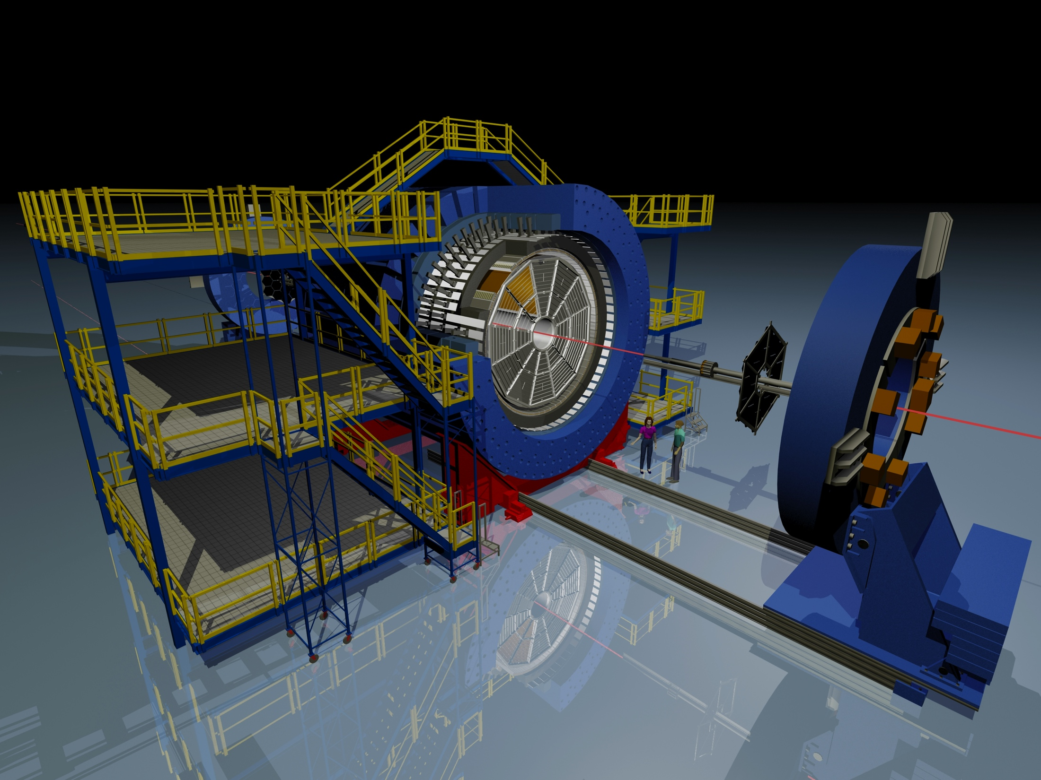
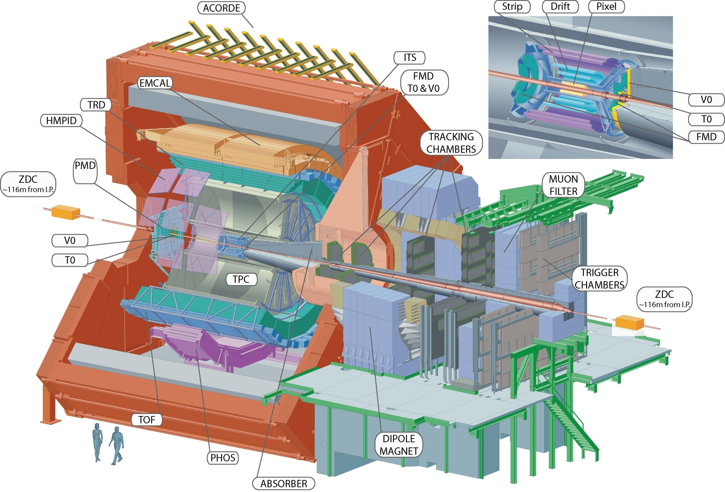
Heavy ion jets in ALICE and STAR: status and update
Peter Jacobs
Lawrence Berkeley National Laboratory
STAR @ RHIC
ALICE @ LHC

Slide 2
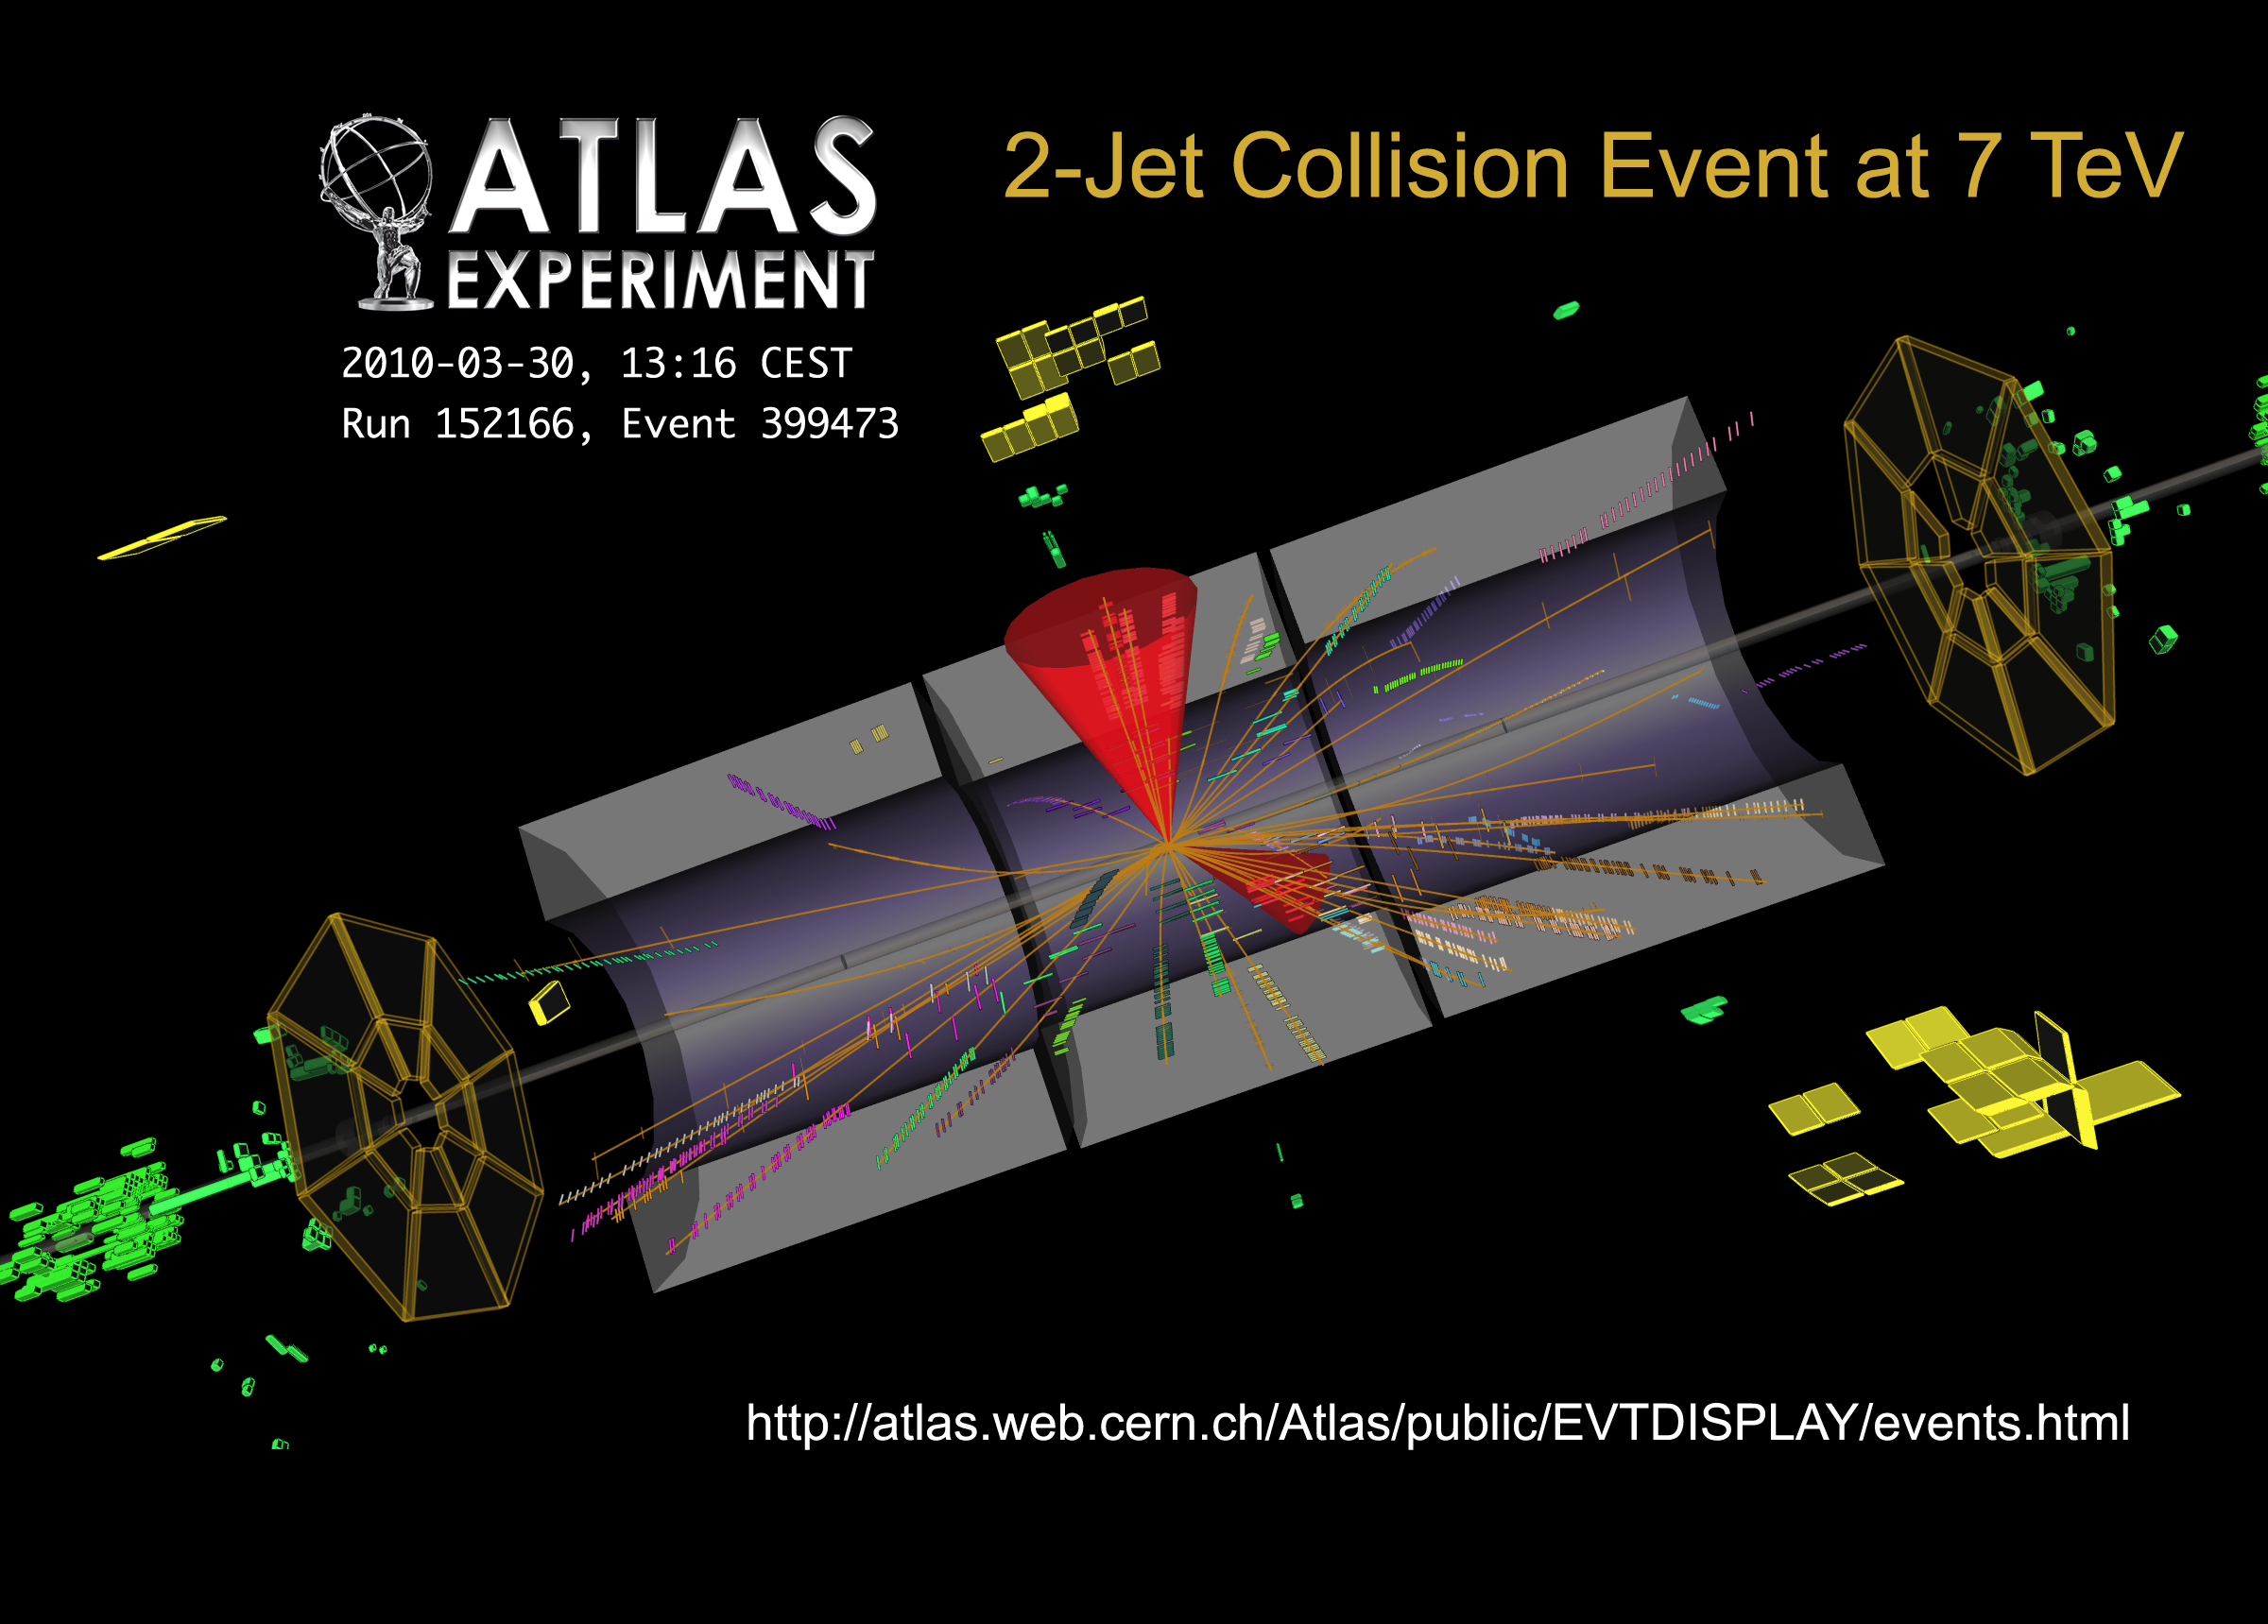
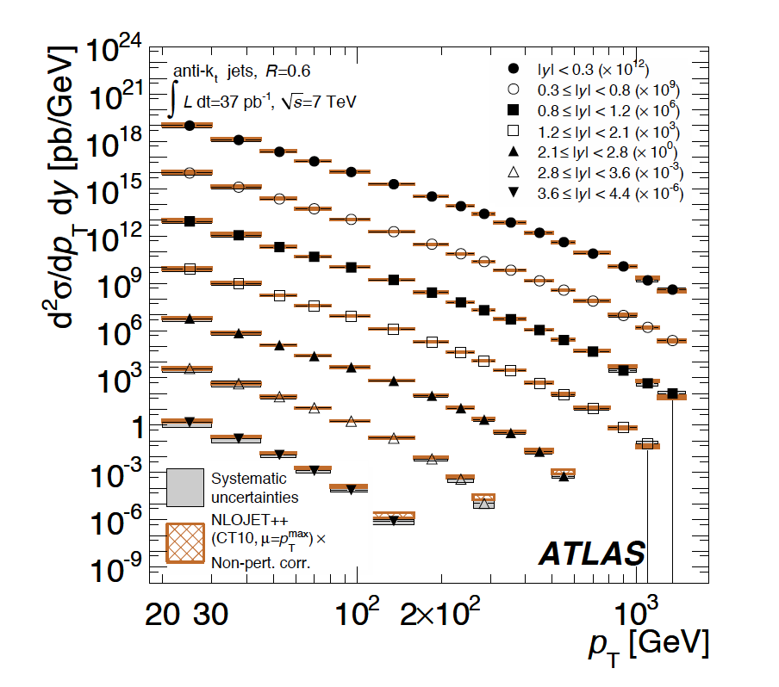
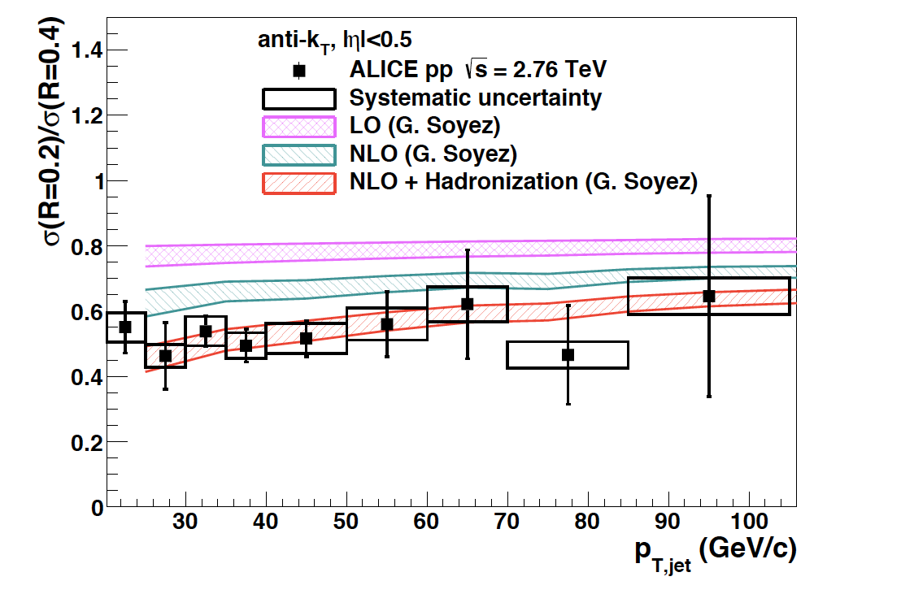
Jet production in proton-proton collisions
Good agreement with pQCD @ NLO over a broad kinematic range
Phys.Rev. D86 (2012) 014022
R. Ma, Ph.D. Thesis
Phys.Lett. B722 (2013) 262

Slide 3
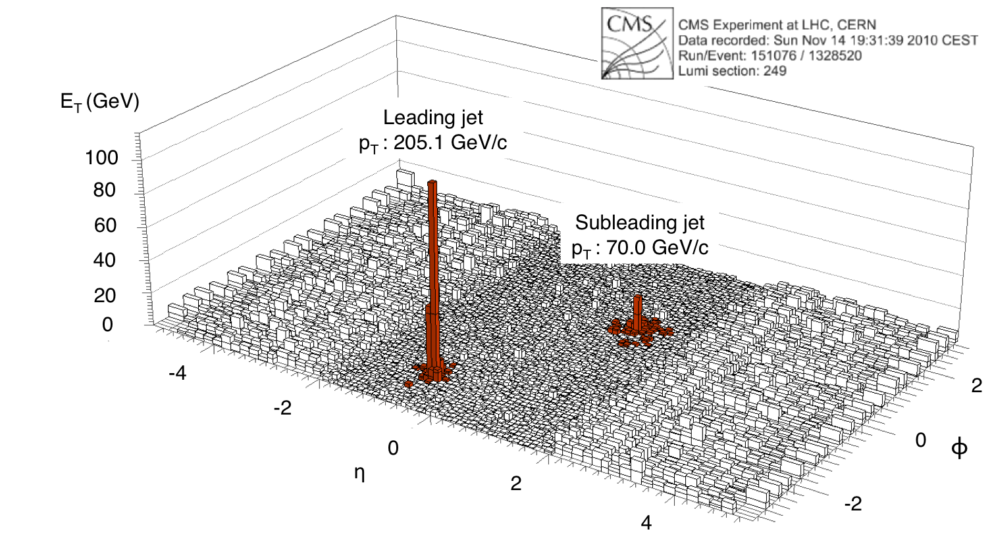
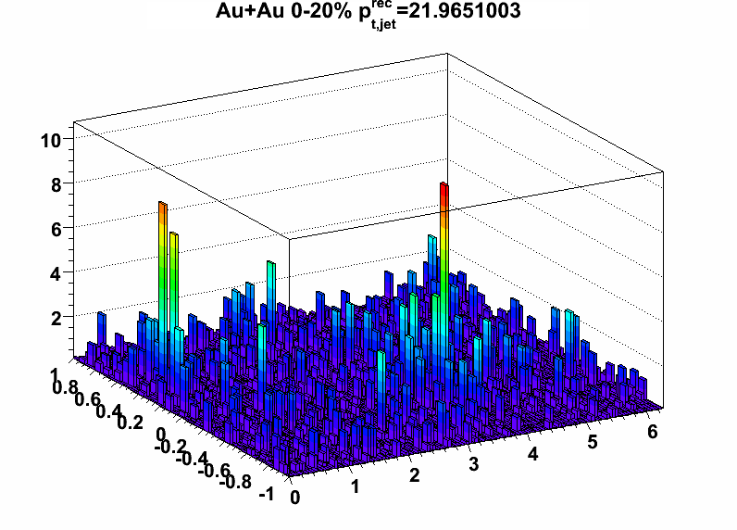
Jets in real heavy ion collisions
LHC/CMS
RHIC/Star
Can we measure jets in heavy ion collisions with the same precision and rigorous connection to theory as in pp collisions?
Visual identification of energetic jets above background is fairly easy
Much harder: accurate measurement of jet energy within finite cone
  Pb+Pb at LHC: on average over 100 GeV of uncorrelated background energy in cone R=0.4
  Uncorrelated background has complex structure, including multiple overlapping jets at all momentum scales

Slide 4
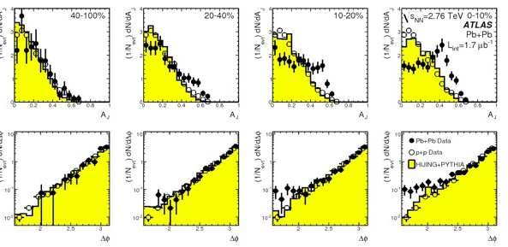
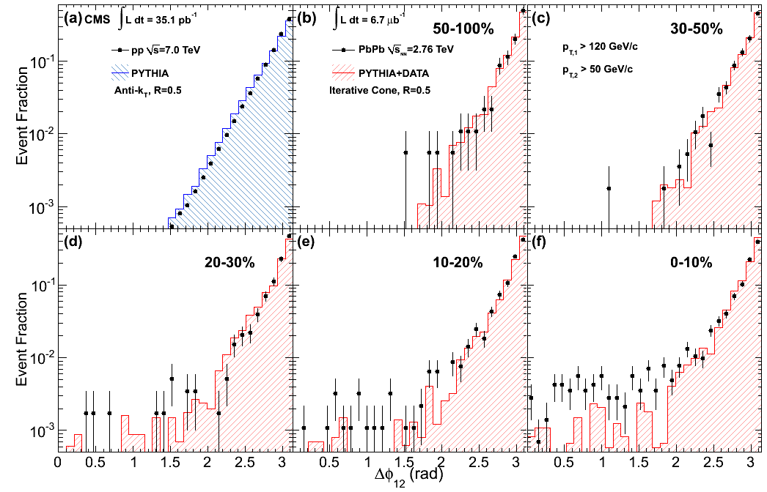
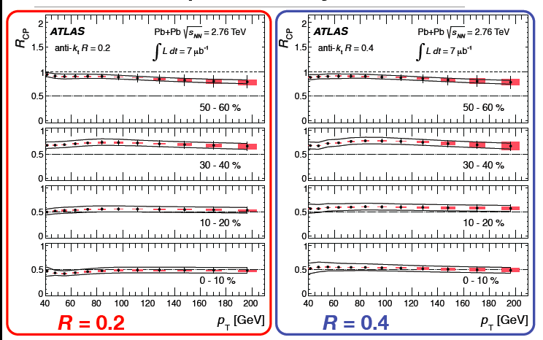
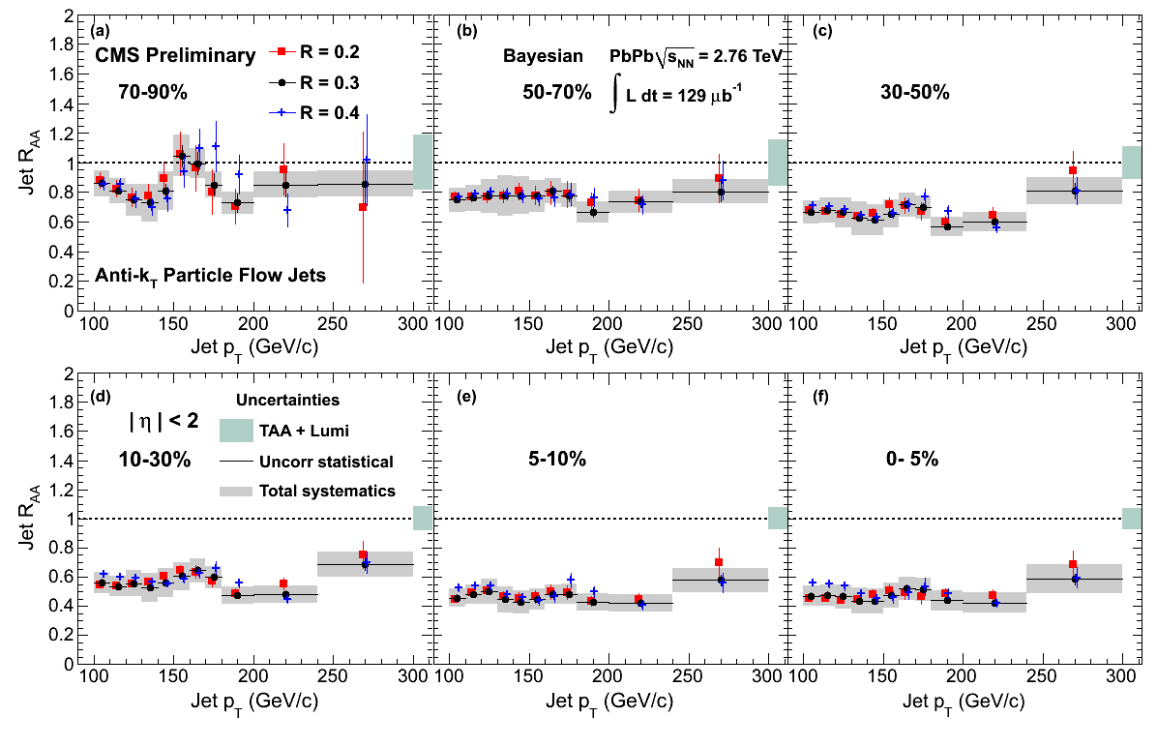
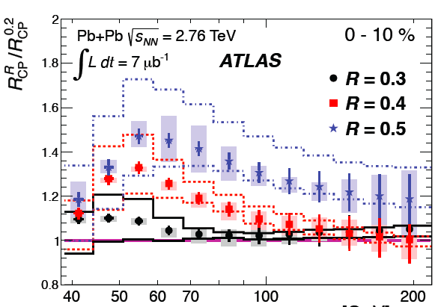
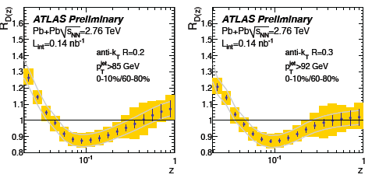
Many beautiful heavy ion jet results from ATLAS and CMS
I won’t discuss any of them

Slide 5
General requirements for heavy ion jet measurements
Simple and transparent selection of jet population: what biases are we imposing?
Correction of jet distributions to particle level for all background and instrumental effects (“unfolding”)
  ➔ Direct comparison to theory (no requirement to model background or instrumental effects)
Same algorithms and approach at both RHIC and LHC
  ➔ well-controlled over the full jet kinematic range (p_{T}^{jet} > ~20 GeV)
  ➔ energy evolution of quenching

Slide 6
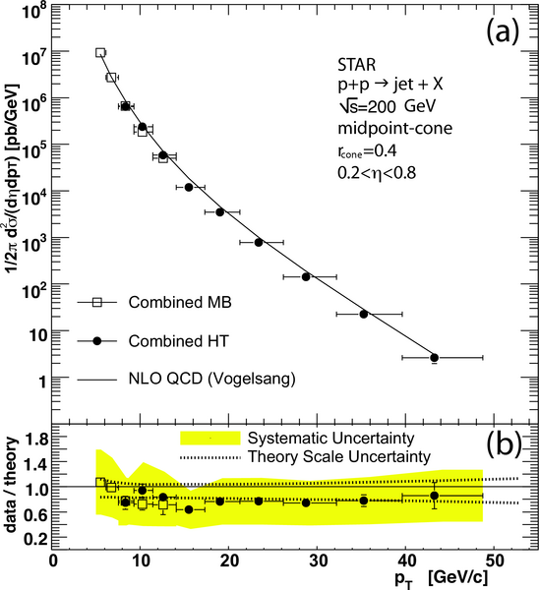
Near-term prospects at RHIC:
STAR jet yields through Run 16
Phys. Rev. Lett. 97 (2006) 252001
Run 11 Au+Au integrated luminosity ~ 2.8/nb
Estimate jet production yield (i.e. R_{AA}=1)
R=0.4
10% central Au+Au: ~2K jets with p_{T}>50 GeV (no quenching)
Run 14 Au+Au @ 200: ~few /nb on tape
STAR BUR Run 16 Au+Au @ 200: 10/nb
  ➔Central Au+Au: ~ 6K jets with p_{T}>50 GeV

Slide 7
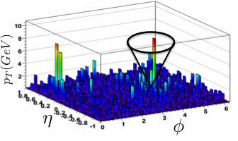
Jets in Heavy Ion Collisions:
STAR/ALICE approach
Assignment of any given track or calorimeter cell to either background or jet signal is not meaningful on an event-wise basis
Only ensemble-averaged distributions of background-corrected signal are meaningful
  ➔No jet selection/rejection based on background-corrected jet energy (contrast ATLAS/CMS)
Instrumentation:
Measurements based on EM calorimetry and tracking (no hadronic calorimetry: contrast ATLAS/CMS)
  Why? Infrared safety:
    ➔can measure individual jet consituents down to p_{T}~200 MeV (tracks, EMCal)
  Same approach for STAR@RHIC and ALICE@LHC
Collinear safety – see later

Slide 8
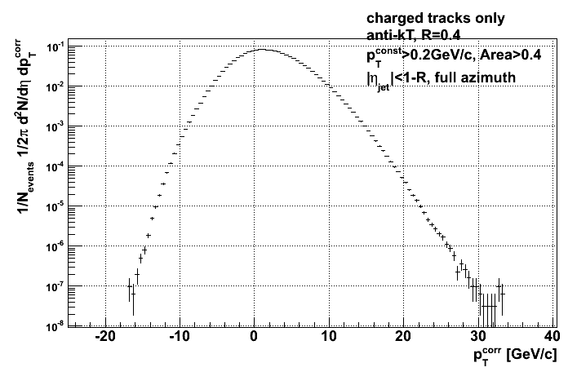
Background density estimate
For each event:
Run jet finder, collect all jet candidates
Tabulate jet energy p_{T,i}^{jet} and area A_{i} ^{jet}
Event-wide median energy density:
STAR Preliminary
Jet candidate p_{T} corrected event-wise for median background density:
~half the jet population has p_{T}^{<corr>} < 0
Not interpretable as physical jets
But we do not reject this component explicitly by a cut in p_{T}^{<corr>}:
  Contains crucial information about background or “combinatorial” jets
  Rejected at later step by imposition of a specific (transparent) bias on candidates
STAR Preliminary

Slide 9
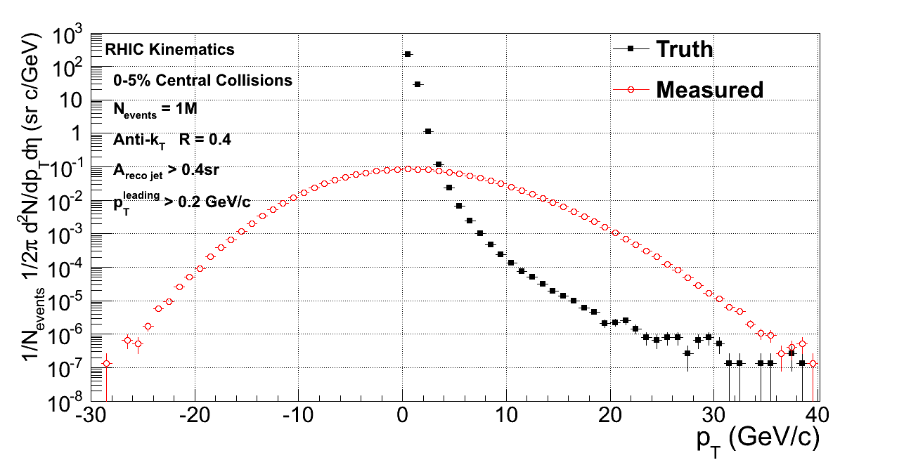
True and measured jet spectra
ATLAS/CMS algorithm:
reject jet candidates based on p_{T}^{<corr>}
Correct for missing yield by simulation
simulation
STAR Preliminary
STAR/ALICE:
keep entire p_{T}^{<corr>} distribution
Reject background based on other observables
Analysis steps:
Isolate the real hard jet component and suppress combinatorial component
“Unfold” the effects of energy smearing on the hard jet component

Slide 10
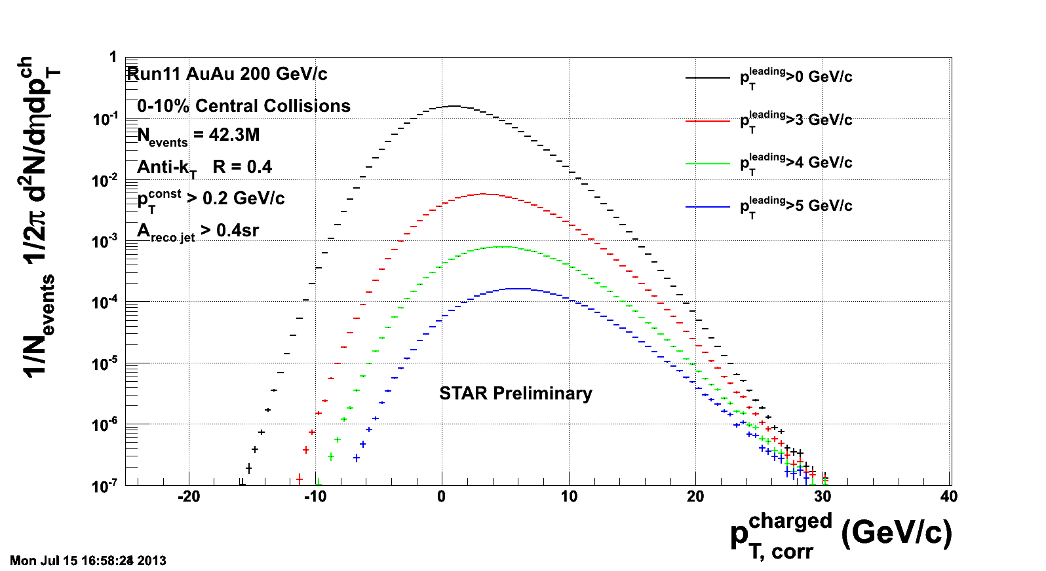
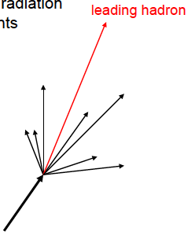
Inclusive jet spectrum: isolation of hard jet component
G. De Barros et al., arXiv:1208.1518
Require leading hadron of each jet candidate to be above p_{T} threshold
  Imposition of momentum scale discriminating hard from non-hard jets
  Infrared-safe: large fraction of jet energy can still be carried by very soft radiation (down to ~200 MeV)
  Collinear-unsafe: minimize p_{T} cut and vary it to assess its effect
unbiased
biased

Slide 11
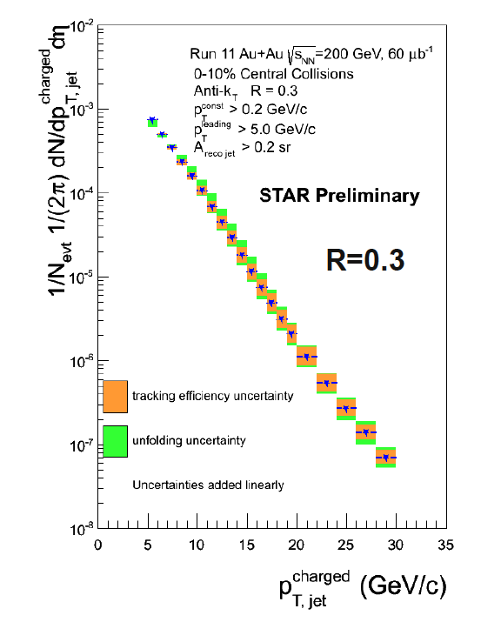
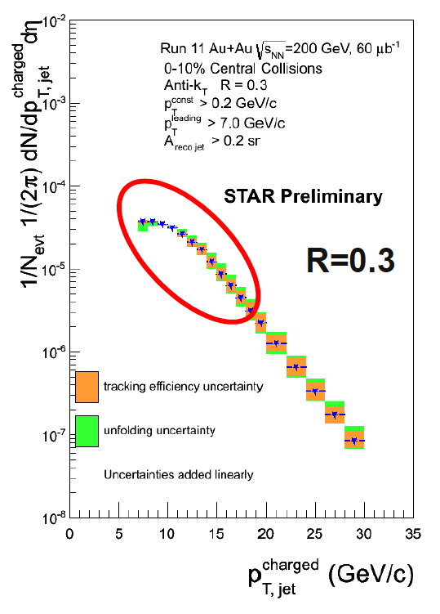
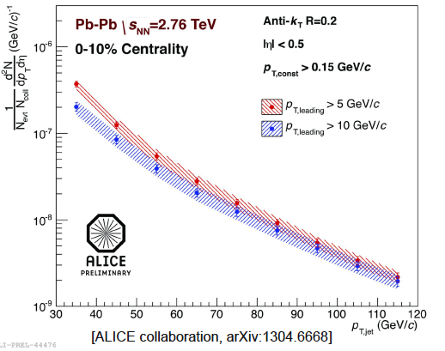
Quasi-inclusive jet spectrum in central heavy ion collisions at RHIC and LHC
STAR central Au+Au
√s_{NN}=200 GeV
Charged jets R=0.3
Jan Rusnak
HP13
ALICE central Pb+Pb
√s_{NN}=2.76 TeV
Full jets R=0.2
p_{T}^{thresh}=5 GeV
p_{T}^{thresh}=7 GeV
Proof of principle: quasi-inclusive jet spectra can be measured with well-controlled systematics over a broad kinematic range at both RHIC and LHC
  In progress: full jets (STAR), larger R at both energies, kinematic reach,…
Effect of leading hadron bias is visible

Slide 12
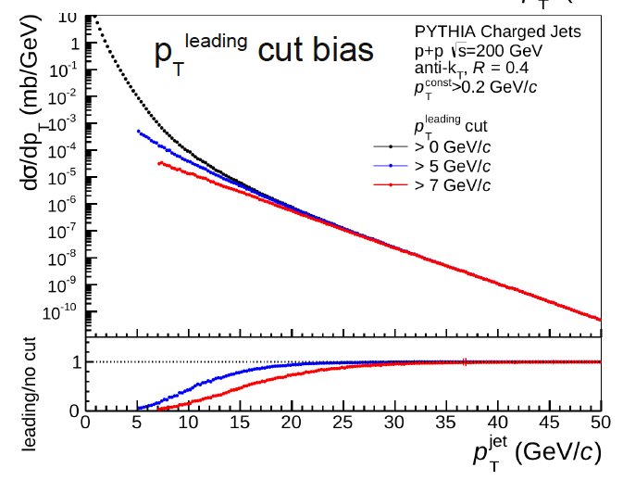
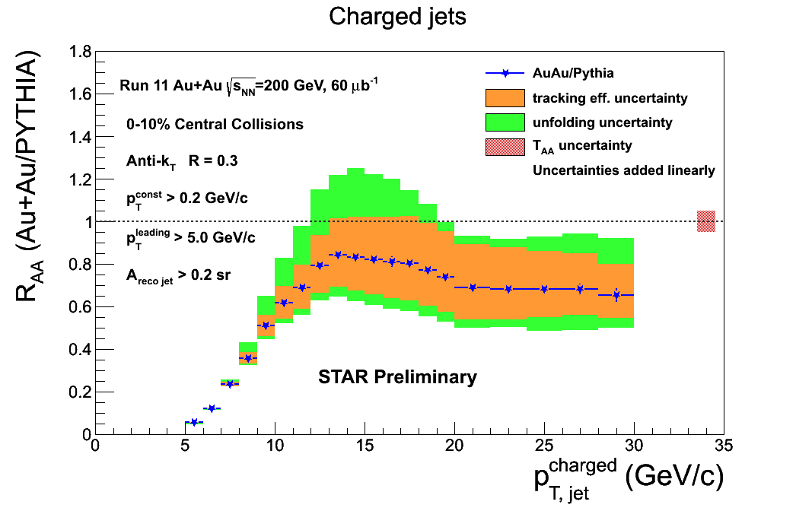
Inclusive jets at RHIC: compare Au+Au and p+p
Ratio of heavy ion jet yield to p+p jet cross section
p+p spectrum with leading hadron bias
biased Au+Au/unbiased p+p
Bias persists to ~few times hadron p_{T} threshold
Bias in Au+Au not markedly different than in p+p
  ➔Vacuum-like jets?

Slide 13
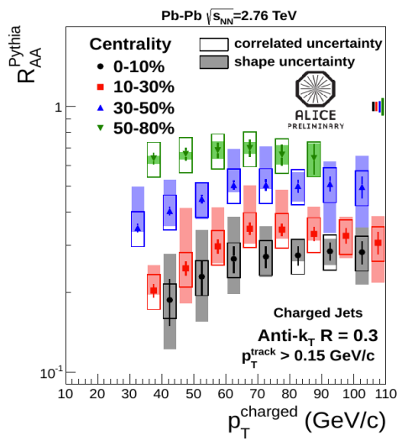
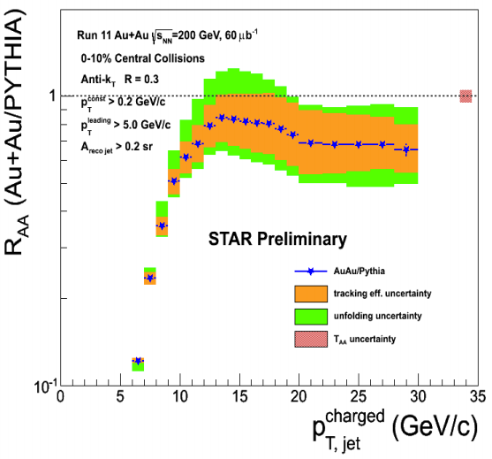
Inclusive jet suppression: RHIC vs LHC
Markedly larger suppression of inclusive jet yield at LHC than at RHIC

Slide 14
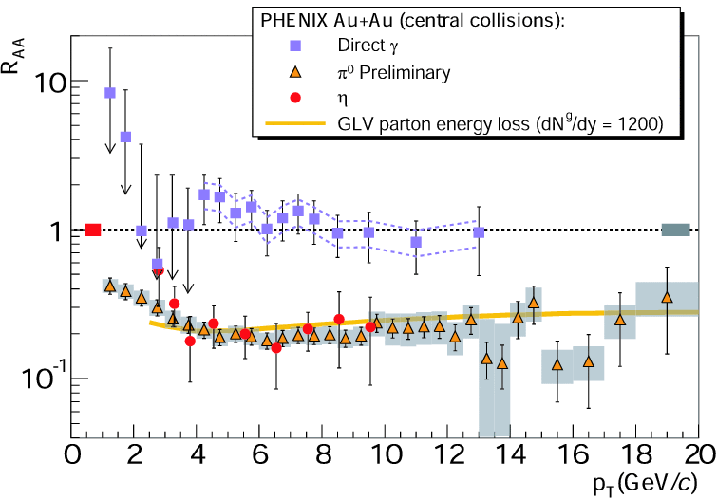
Hadron vs jet suppression at RHIC
Ratio of heavy ion jet yield to p+p jet cross section
Jets are markedly less suppressed than hadrons at RHIC
Contrast LHC, where jet and hadron suppression are similar
  ➔Less out-of-cone radiation at RHIC?
Result is suggestive; improved systematics and kinematic reach in progress
Next step: comparison to theory calculations

Slide 15
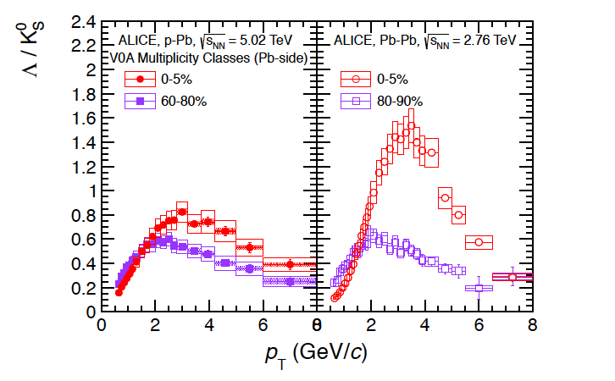
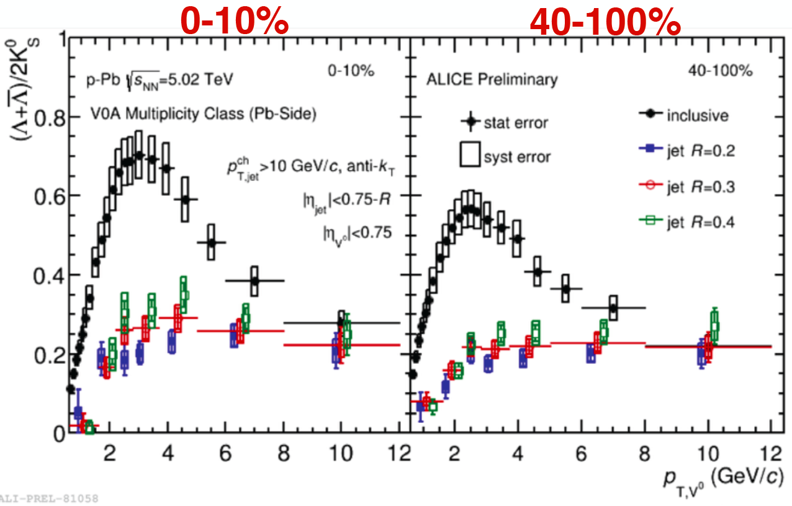
ALICE: Λ/K⁰_{S} ratio in jets in p+Pb
ALICE PhysLett B719 (2012) 29
Previous result: baryon enhancement (Λ/K) seen in high multiplicity p+Pb (no jet requirement)
X. Zhang, QM14
New analysis: look at Λ/K inside jets vs UE in p+Pb
Conclusion: Λ/K enhancement is not correlated with jet hadronization
  ➔Implications for coalescence models?

Slide 16
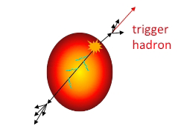
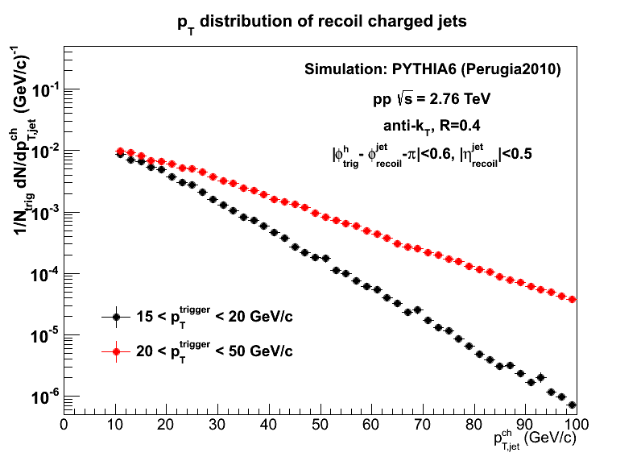
And now for something completely different: hadron+jet correlations
Semi-inclusive yield of jets recoiling from a high p_{T} hadron trigger
Measured
Calculable in fixed-order pQCD
p+p (Simulated)
Consider two different trigger p_{T} intervals
High p_{T}^{trigger} ➔harder recoil spectrum
  biases towards higher Q² processes

Slide 17
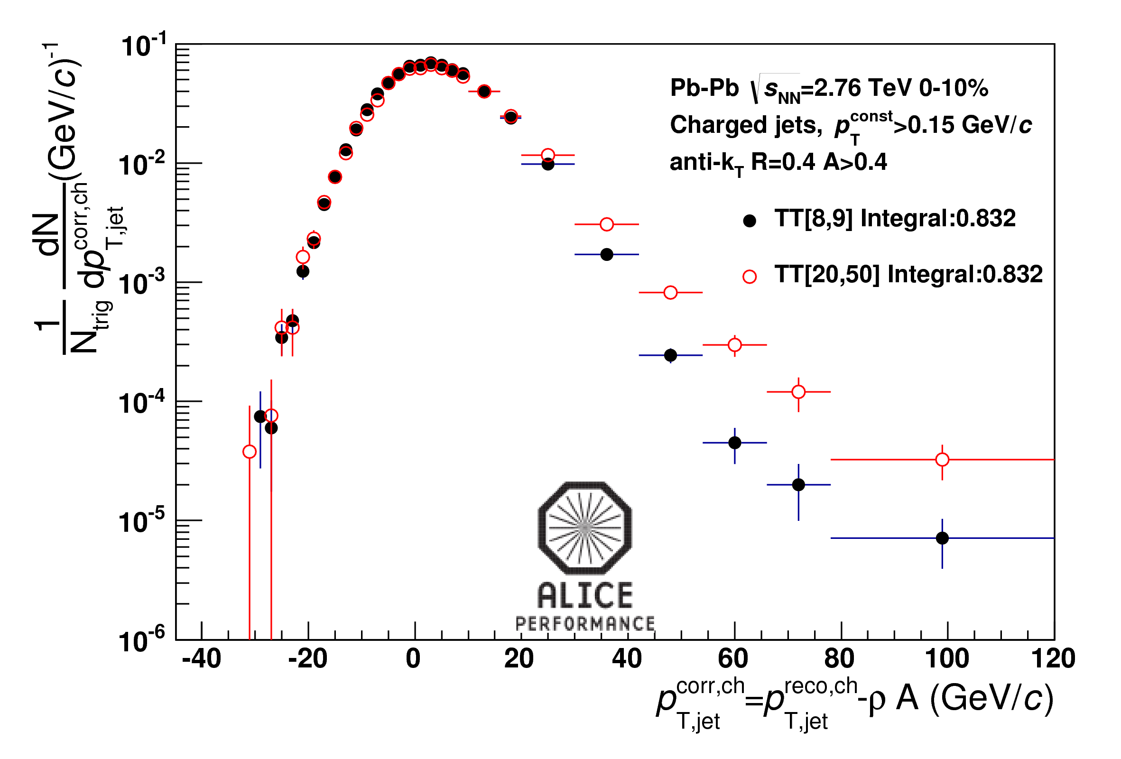
Semi-inclusive h+jet in p+p and Pb+Pb @ LHC
Leticia Qunqueiro, CERN
Rongrong Ma, BNL
p+p (Simulated)
Central Pb+Pb (data)
p_{T}^{corr}<0:
Expectation: dominated by combinatorial (noise) jets
Observation: distr. uncorrelated with p_{T}^{trigger} ✔
p_{T}^{corr} large and positive:
Expectation: hard recoil jets from true coincidences
Observation: distr. strongly correlated with p_{T}^{trigger} ✔

Slide 18
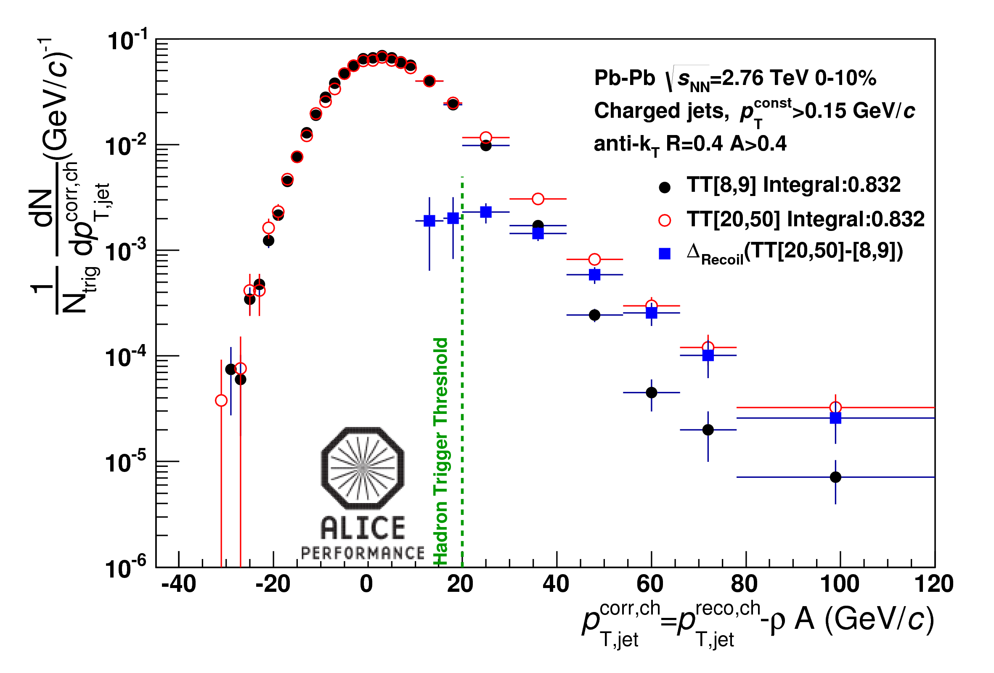
h+jet: Δ_{Recoil}
G. De Barros et al., arXiv:1208.1518
Opportunity: take difference of spectra
Precisely removes combinatorial jet contribution w/o jet selection bias
Works robustly for R=0.5
Correct to particle level for instrumental effects and bkgd fluctuations (“unfolding”)
Ensemble-averaged analysis: no rejection of jet candidates on a jet-by-jet basis
jet measurement is collinear-safe with low IR cutoff (0.2 GeV/c)
directly comparable to pQCD calculations (vacuum and quenched)
But there is a price: this is the evolution of the recoil jet population with variation in p_{T}^{trig}

Slide 19
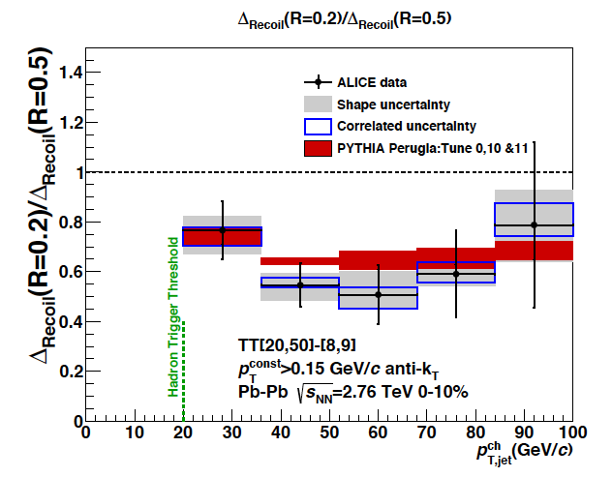
h+jet in p+p and Pb+Pb: jet broadening due to quenching?
Ratio of differential recoil yields
  R=0.2/R=0.5
Compare ratios for central
Pb+Pb and p+p
No significant evidence of jet broadening due to quenching within R=0.5

Slide 20
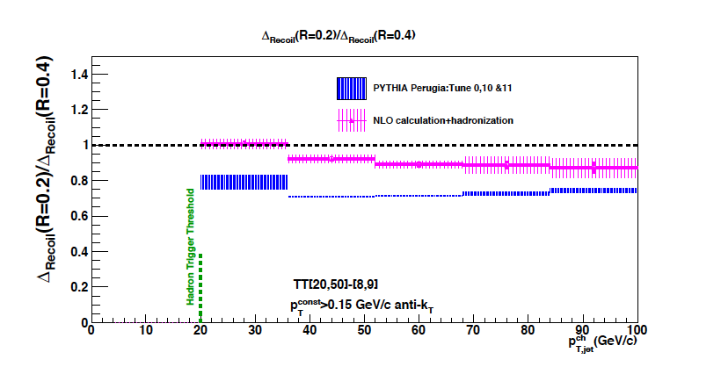
Vacuum reference: NLO vs MC shower
NLO: D. de Florian arXiv:0904.4402
MC shower and NLO differ
Compare ALICE p+p@7 TeV (not shown): MC shower strongly favored
Important lesson for jet quenching via pQCD@NLO
p+p √s=2.76 TeV

Slide 21
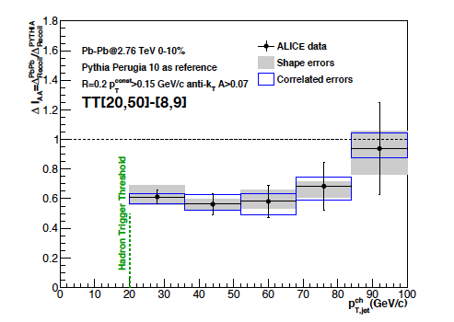
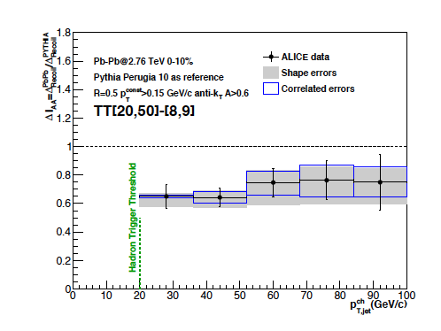
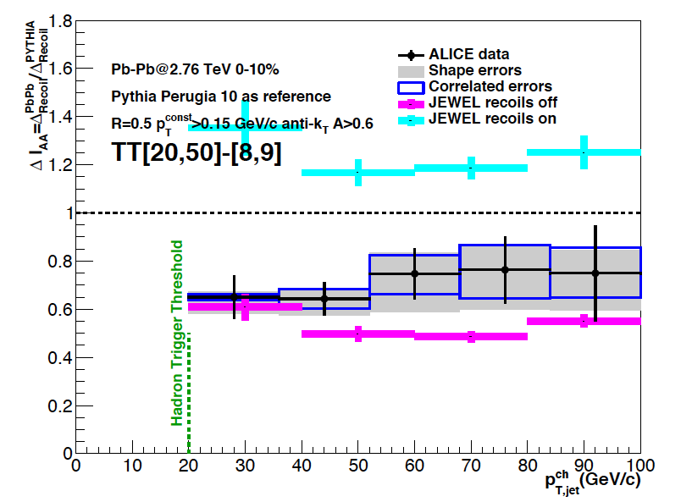
Recoil yield suppression: ΔI _{AA}
pp reference: PYTHIA Perugia 10
R=0.2
Compare to quenching MC: JEWEL
R=0.5
R=0.5

Slide 22
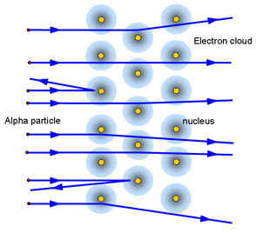
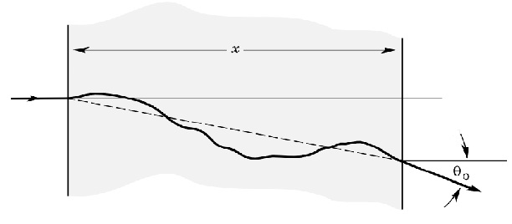
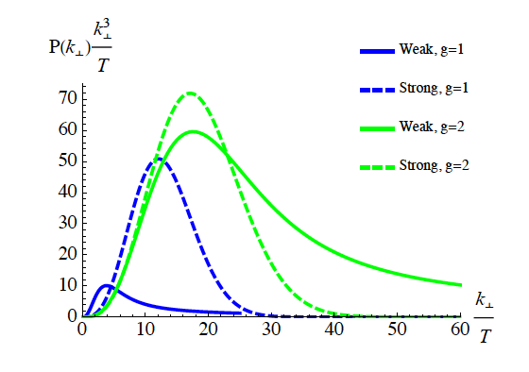
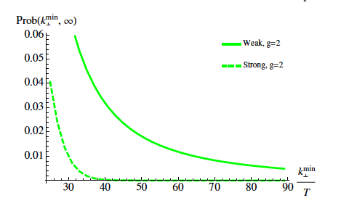
Large-angle scattering off the QGP
d’Eramo et al, arXiv:1211.1922
Discrete scattering centers or effectively continuous medium?
Look at the rate of large-angle deflections
(DIS-like scattering off the QGP)
What are the quasi-particles?
Weak coupling: pQCD: finite temperature plays the role of mass to generate large angle scattering
Strong coupling: AdS/CFT
Strong coupling:
Gaussian distribution
Weak coupling:
  hard tail

Slide 23
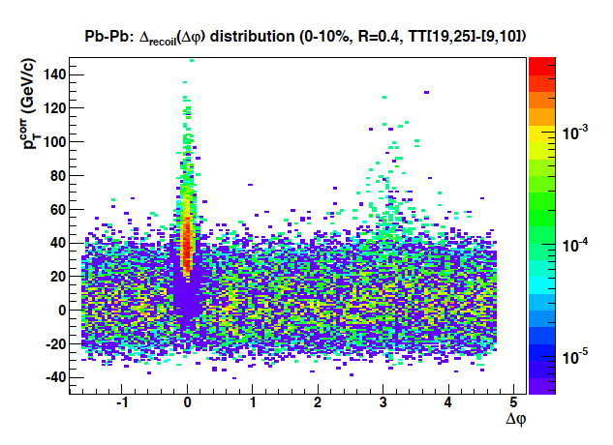
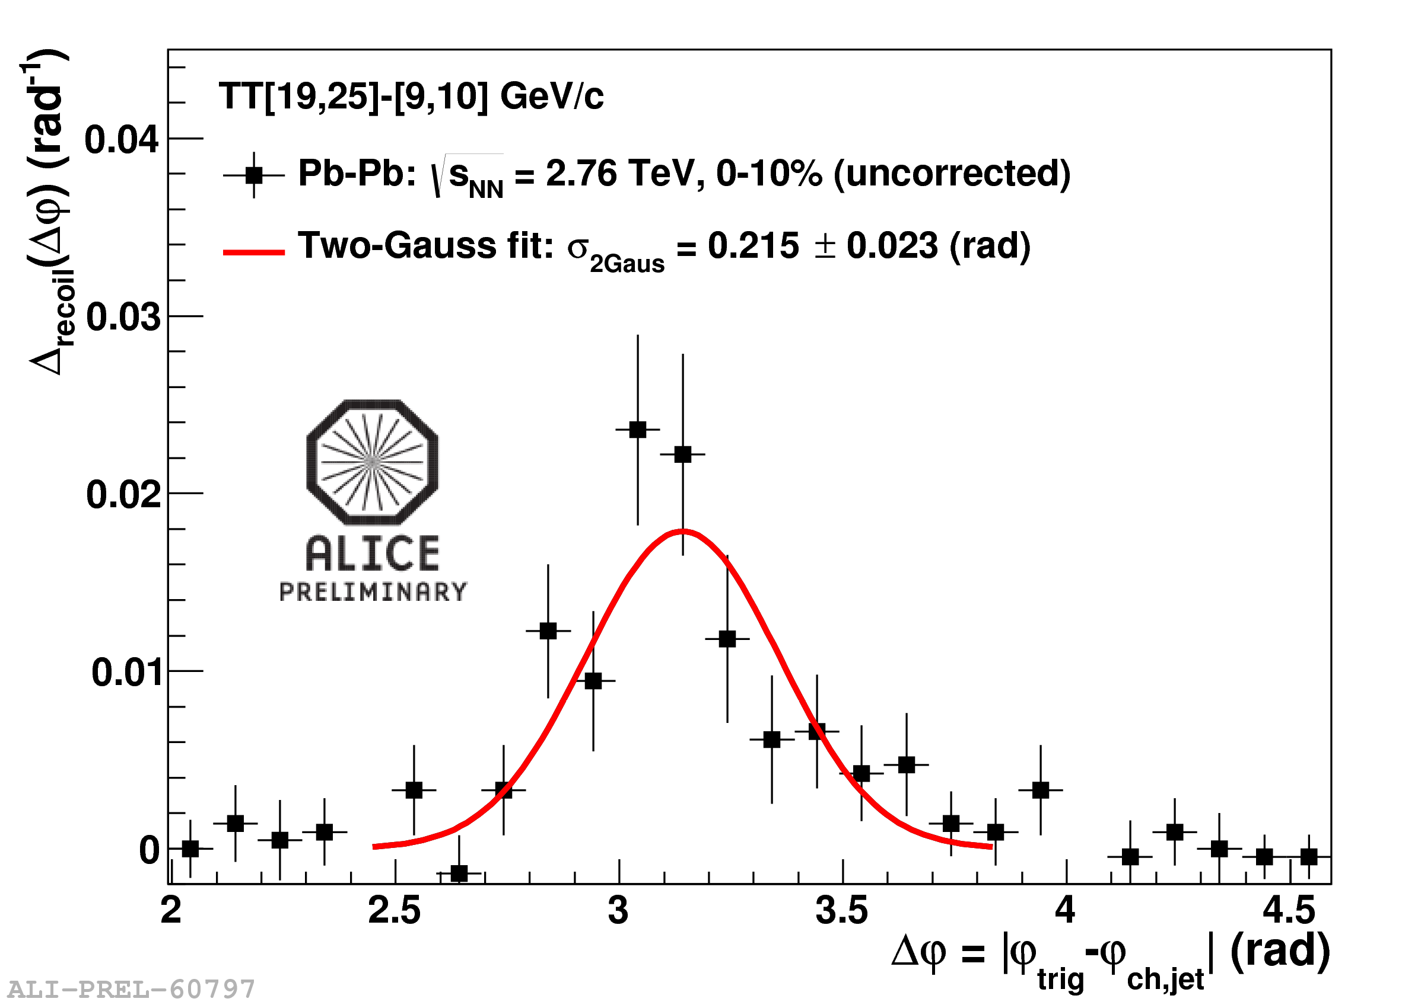
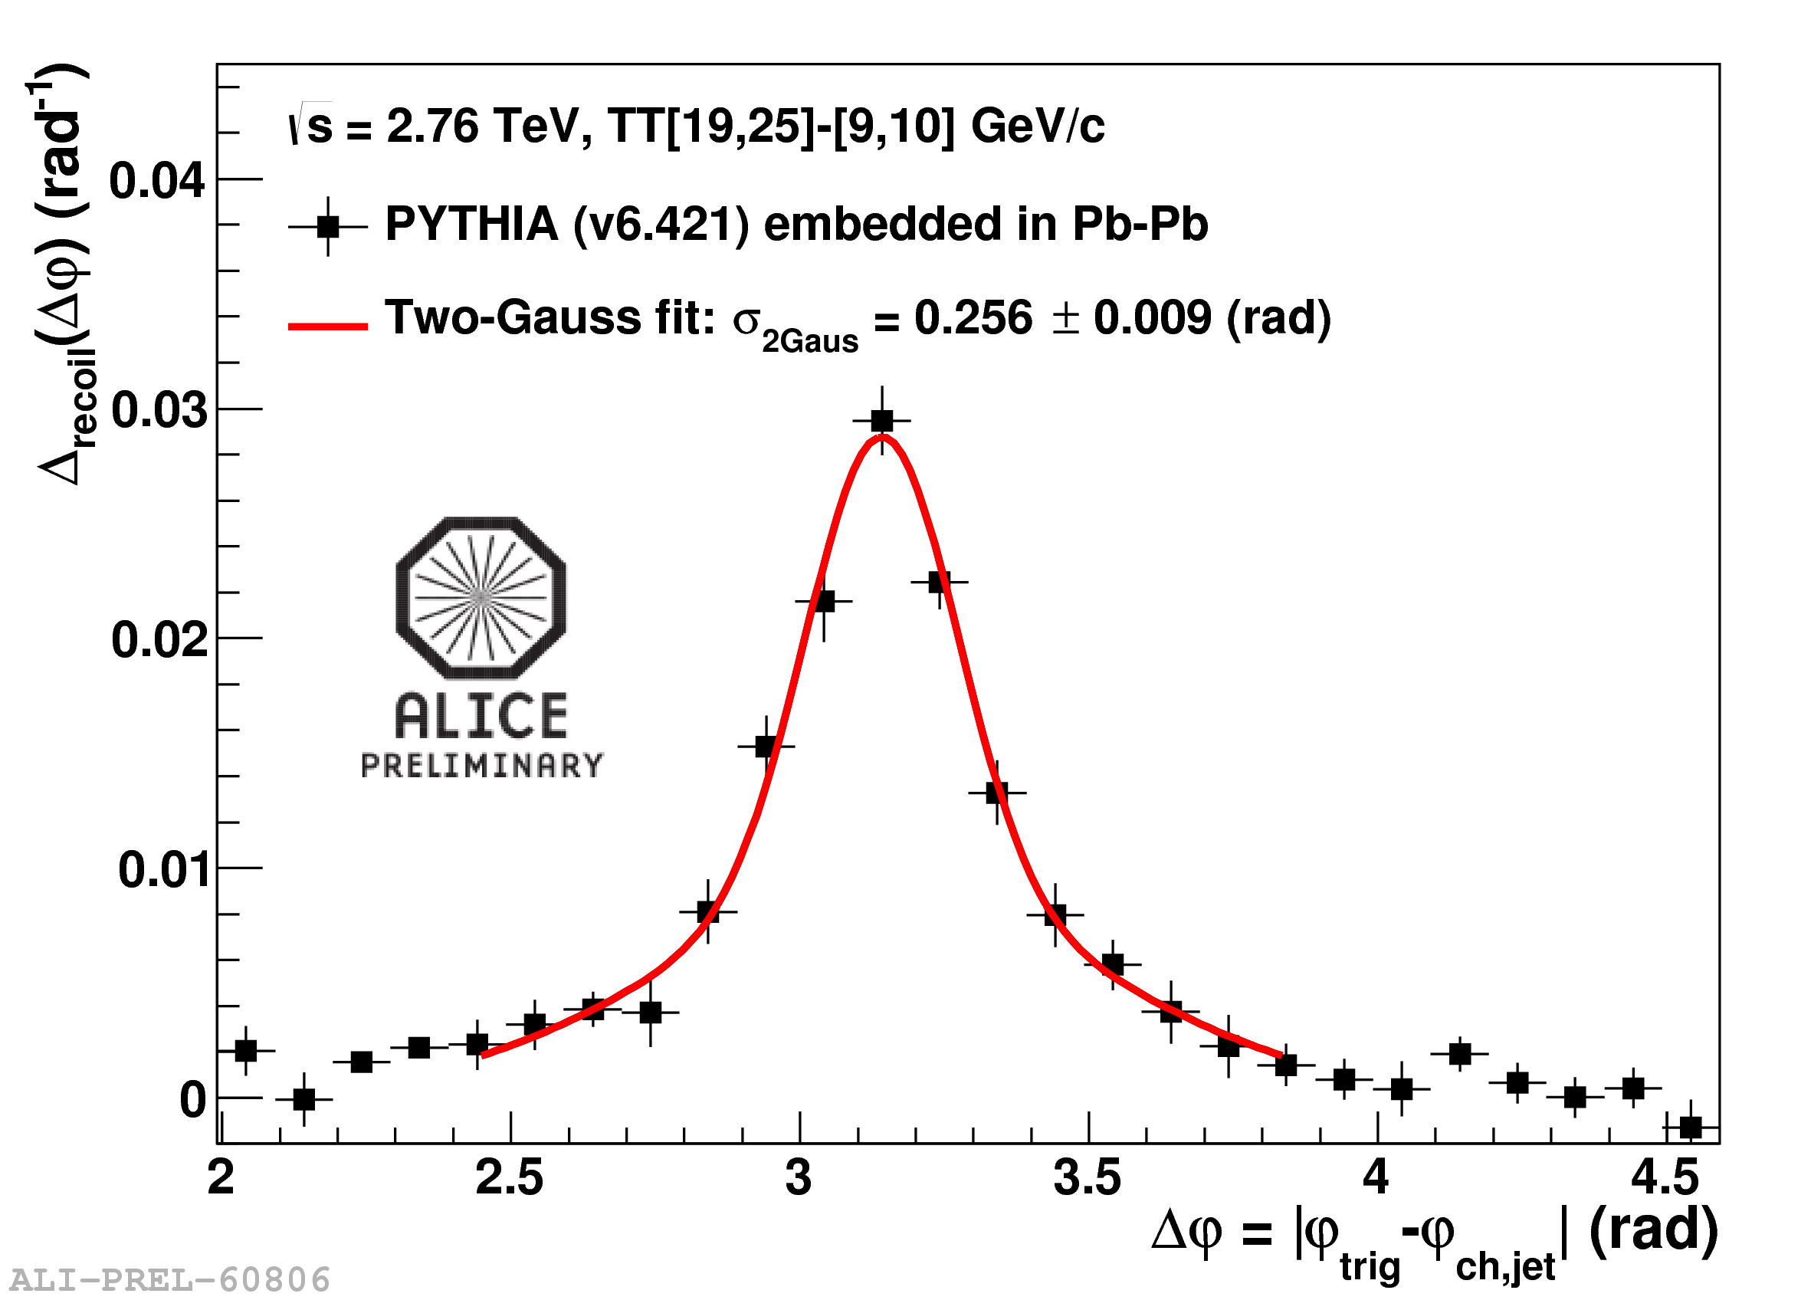
h+jet @ LHC: medium-induced acoplanarity?
Δφ
“Rutherford experiment”: look at rate of large-angle scattering…?
Compare to p+p (PYTHIA)
No evidence of medium-induced acoplanarity
d’Eramo et al, arXiv:1211.1922

Slide 24


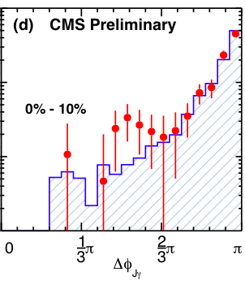


CMS : photon-jet angular correlation
“QGP Rutherfold experiment”
Anti-k_{T} jet R = 0.3
PbPb
Photon
Jet
pp
pp
pp
Photon
“Backscattering?”
Jet
Azimuthal angle difference between photon and jet
PLB 718 (2013) 773

Slide 25
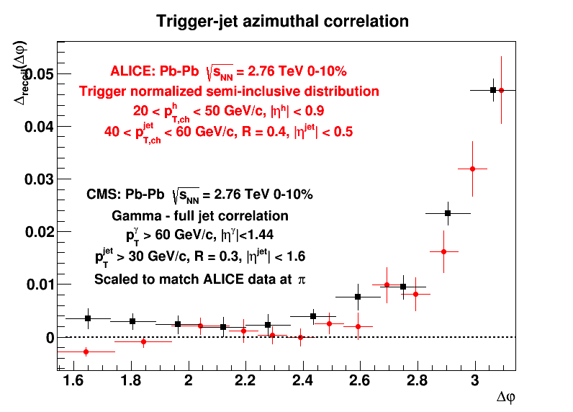
Compare CMS γ+jet/ALICE h+jet
Many differences: trigger, jet kinematics, jet selection bias, parton flavor bias,…
But still: distributions are similar
Difference in tails….?

Slide 26
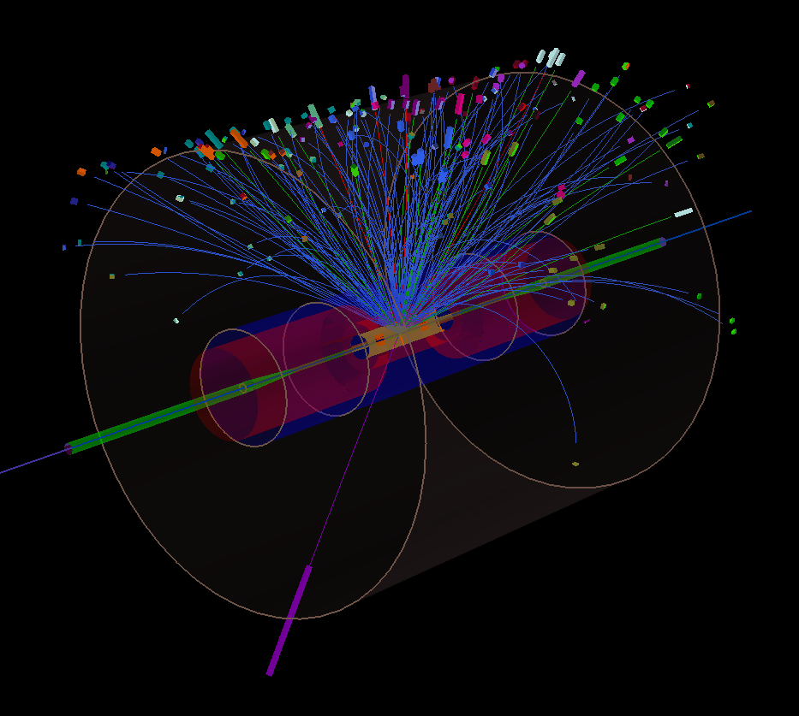
h+jet correlations in STAR: 200 GeV Au+Au
Dataset: year 11 200 GeV Au+Au
70M 0-10%, 140M 60-80%
Charged hadron trigger: 9<p_{T}<19 GeV/c
Charged particle jets:
Anti-k_{T} R=0.3
Constituents: track p_{T}>0.2 GeV/c
Jet recoil azimuth: |φ-π| < π/4
Recoil jets
Semi-inclusive observable: recoil jets per trigger
Trigger hadron

Slide 27
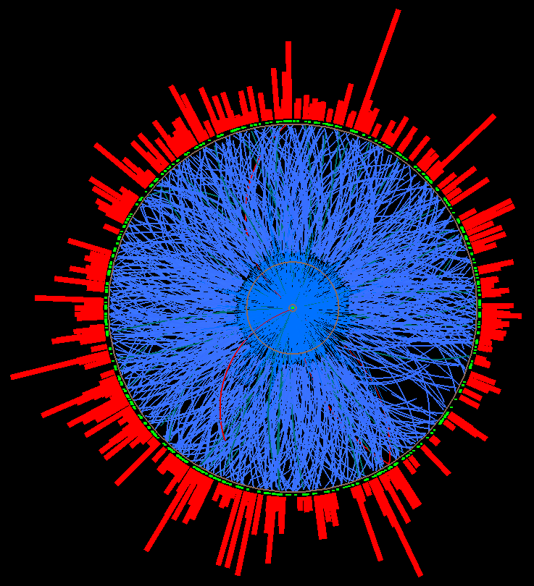
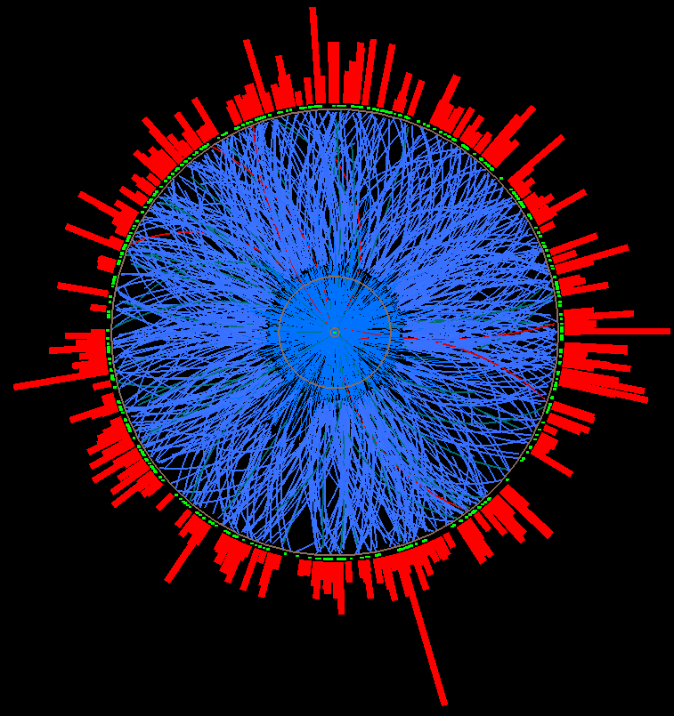



New method to measure combinatorial
jet background: mixed events
Mixed event
Sample number of tracks from real event distribution, e.g. 765 tracks
→ use 765 events in buffer
Alex Schmah, LBNL
For every centrality bin, Ψ_{EP} bin,
z-vertex bin
Pick one random
track per real event
→ add to mixed
event, remove
from list
…
Real events
Ev. 1
Ev. 2
Ev. 3
Ev. 765

Slide 28


h+jet in STAR: data vs mixed events
Au+Au 60-80%
Au+Au 0-10%
Mixed events give precise description of combinatorial background
  ➔Trigger-correlated jet distribution: subtract ME from data
Comparable to ALICE h+jet measurement

Slide 29


STAR h+jet: subtracted distributions
Compare to theory: should correct background-subtracted Au+Au distributions to the particle level
  unfold for background fluctuations and detector effects
  but not yet done
Currently: compare Au+Au background-subtracted distributions to PYTHIA p+p smeared by background fluctuations and detector effects
Au+Au 60-80%
Au+Au 0-10%
Peripheral Au+Au: good agreement between data and PYTHIA
Central Au+Au: strong suppression relative to PYTHIA
29

Slide 30
h+jet yield suppression: RHIC vs LHC
STAR central Au+Au
ALICE central Pb+Pb
R=0.5
Are these consistent?
Convert vertical suppression into horizontal shift: energy trasnport out of jet cone
    RHIC: ΔE ~ 5 GeV
    LHC: ΔE ~ 7 GeV
“Chi-by-eye”, to be done more precisely

Slide 31



h+jet azimuthal distributions: RHIC vs LHC
Δφ
200 GeV Au+Au 0-10%
Au+Au 60-80%
Au+Au 0-10%
Pb+Pb 2.76 TeV 0-10%
40<p_{T}^{corr}<60 GeV
AuAu central vs peripheral: No evidence of large-angle scattering
RHIC vs LHC: comparable widths
Current precision is limited but dominant uncert. is systematic: “systematically improvable”

Slide 32

STAR: A_{J} of biased jets
J. Putschke, QM2014
Full jets (with BEMC), Run 7 data

Slide 33


A_{J} of biased di-jets
J. Putschke, QM2014
My preferred observable for this analysis: ΔA_{J}
ΔA_{J} = shift in A_{J} with constituent cut 2 GeV ➔ 0.2 GeV
Calculated on a pair-wise basis
Includes negative shifts, flipping of trigger/recoil assignment
ΔA_{J} central Au+Au vs p+p: minor differences compared to overall shift
  ➔ vacuum like jets? Bias towards tangential pairs?

Slide 34
How important is jet selection bias?
A_{J}: biased pairs
h+jet: unbiased recoil
Little difference between central Au+Au vs p+p
Vacuum-like: tangential pairs?
Small if any out of cone radiation
Strong yield suppression of central Au+Au vs p+p:
large out-of-cone radiation
The bias has significant effect…

Slide 35

New idea I:
EPJ C73, 2319(2013)
Define event-averaged moments of hadron p_{T} distribution in jets:
Moments are theoretically well-defined: DGLAP-like evolution
Heavy ion measurements: unfold bkgd fluctuations at the ensemble level
in the same spirit as the STAR/ALICE approach to incl/semi-incl jet measurements
systematically improvable precision

Slide 36


New idea II: intrinsic charm in jets
D-meson fragmentation function:
ATLAS, PRD 85, 052005 (2012)
STAR Phys. Rev. D 79 (2009) 112006
Is this of interest in heavy ions?
Perhaps: g->c+cbar may be a “direct messenger” from the parton shower
    ➔ even more ambitious: c+cbar correlations
New vertex detectors are crucial (HFT, PHENIX VTX)
Very luminosity-hungry: STAR estimates TBD

Slide 37
Outlook
Not discussed here: sPHENIX
  Towards Long Range Plan: discussions initiated between STAR and PHENIX to develop unified plan for RHIC jet physics
Jet quenching continues to be a rich and broad topic, both experimentally and theoretically
Strong RHIC jet program for years to come
Needs continued close collaboration between theory and experiment

