Slide 1


Recombination MC for Jet Showers:
Status and Discussion
JET Collaboration Meeting
UC Davis, June 18, 2014
Rainer Fries
Texas A&M University
With
Kyongchol Han
Che-Ming Ko
JET Reco Working Group

Slide 2
Outline
Reminder: In-medium hadronization
The Jet Recombination Formalism
Application to in-medium shower MCs
Outlook and plans
Other stuff

Slide 3
Recombination in Jet Showers
JET goal related to NSAC Performance Measures: Complete realistic calculations of jet production in a high energy density medium for comparison with experiment. (DM7)
  This includes chemical composition
Well-established hadronization models for vacuum shower Monte-Carlo’s
  Lund string fragmentation
  Cluster hadronization
How to generalize to jets in a medium?
Recombination: some early work on vacuum showers.
Challenge: get vacuum fragmentation right.
Advantage: medium effects are straight forward to implement; does well with heavy ion single particle spectra.
[R. Migneron, M. E. Jones, K. E, Lassila, PLB 114, 189 (1983)]
[R.C. Hwa and C.B. Yang, PRC 70, 024904 (2004); 024905 (2004)]

Slide 4
Recombination in Jets
Bulk hadronization: recombination is successful b/c of large phase space occupation.
Jets: ~10¹ quarks+antiquarks in a narrow phase space volume; quarks in the “jet bulk” (small z) might be packed close enough to recombine.
This situation will improve dramatically if the jet is in a medium.
Isolated quarks (not in the “jet bulk”): need to revert to strings

Slide 5
Progress in the JSR Formalism
Lots of feedback at the last collaboration meeting and at the Wayne State NLO/MC Meeting.
Improvements:
  Full implementation of space-time information → recombination through Wigner function overlap in phase space.
  Wigner function width fixed by hadron charge radii: reducing the number of unconstrained parameters.
  Improved treatment of non-perturbative gluon splitting
  Moved treatment of remnant partons from sampling of AKK fragmentation functions to string fragmentation.
This is version number 1.0: paper has been written up.

Slide 6
Baseline: String Fragmentation (PYTHIA)
Perturbative PYTHIA parton showers evolved to a scale Q₀.
Standard PYTHIA Lund string fragmentation:
Phenomenologically successful.
Goal: reproduce main aspects of PYTHIA (string) hadron production with the recombination model.
Lund String
String Decay

Slide 7
Formalism (I): Prepare Shower
Perturbative PYTHIA parton showers evolved to a scale Q₀.
Decay gluons with remaining non-perturbative virtualities into quark-antiquark pairs.
Isotropic decay in the gluon restframe.
Decay chemistry (only up, down, strange quarks)
Force gluon decay

Slide 8
Formalism (I): Prepare Shower
Example: Sample of 10⁶ PYTHIA parton showers with E_{jet} = 100 GeV.
dN/dz before vs after gluon decay

Slide 9
Formalism (II): Recombination
Use a Monte Carlo version of the instantaneous recombination model by Greco, Ko and Levai.
Projection of partons onto meson and baryon states.
Equivalent to 2 → 1, 3 → 1 processes.
Can be rewritten in terms of Wigner functions.
Force gluon decay
Recombine

Slide 10
Formalism (II): Recombination
Meson and baryon yields:
Meson and baryon Wigner functions:
  Shape from harmonic oscillator potentials
  Width from hadron charge radii
W_{B}

Slide 11
Formalism (II): Recombination
Quantum numbers treated statistically via statistical factors
Charge radius from PDG → Wigner function widths for stable particles
Light resonance are important.
Recombination probabilities evaluated in the hadron rest frame.
Throw dice to determine actual recombination partners.

Slide 12
Formalism (III): Remnant Strings
Naturally there are remnant quarks and antiquarks which have not found a recombination partner.
Why? No confinement in parton shower, quarks can get far away.
In reality: colored object needs to stay connected.
Return these partons to PYTHIA to connect them with remnant strings.
Force gluon decay
Recombine
Remnant strings

Slide 13
Formalism (III): Remnant Strings
“Bulk” low-z quarks like to recombine.
Lonely high-z quarks like to fragment.
→ High–z part of the jet guaranteed to hadronize as in the vacuum.

Slide 14
Model Summary
We replaced string fragmentation in the jet “bulk” by recombination.
Standard PYTHIA Lund string fragmentation:
Our approach:
Lund String
Force gluon decay
String Decay
Recombine
Remnant strings
String Decay

Slide 15
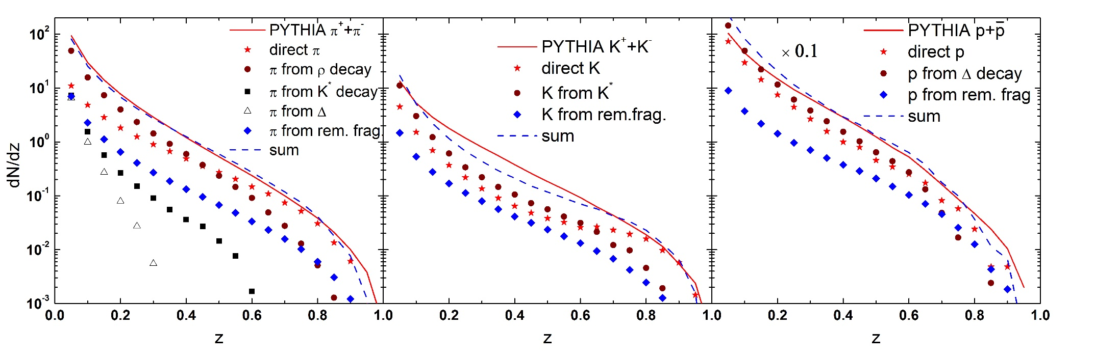
Results and Comparison: Longitudinal
Longitudinal structure: dN/dz of stable particles compared to PYTHIA string fragmentation.
100 GeV jets

Slide 16

Results and Comparison: Transverse
Transverse structure: Jet Broadening
Little difference between PYTHIA parton and hadron (string fragmentation) showers.
Our shower recombination reproduces PYTHIA results.
t.
100 GeV light quark jets in e⁺+e⁻

Slide 17

Adding Medium Partons
Sampling thermal partons from a blastwave models or hydro.
Allow recombination of shower partons with thermal partons.
Recombine
Remnant strings

Slide 18
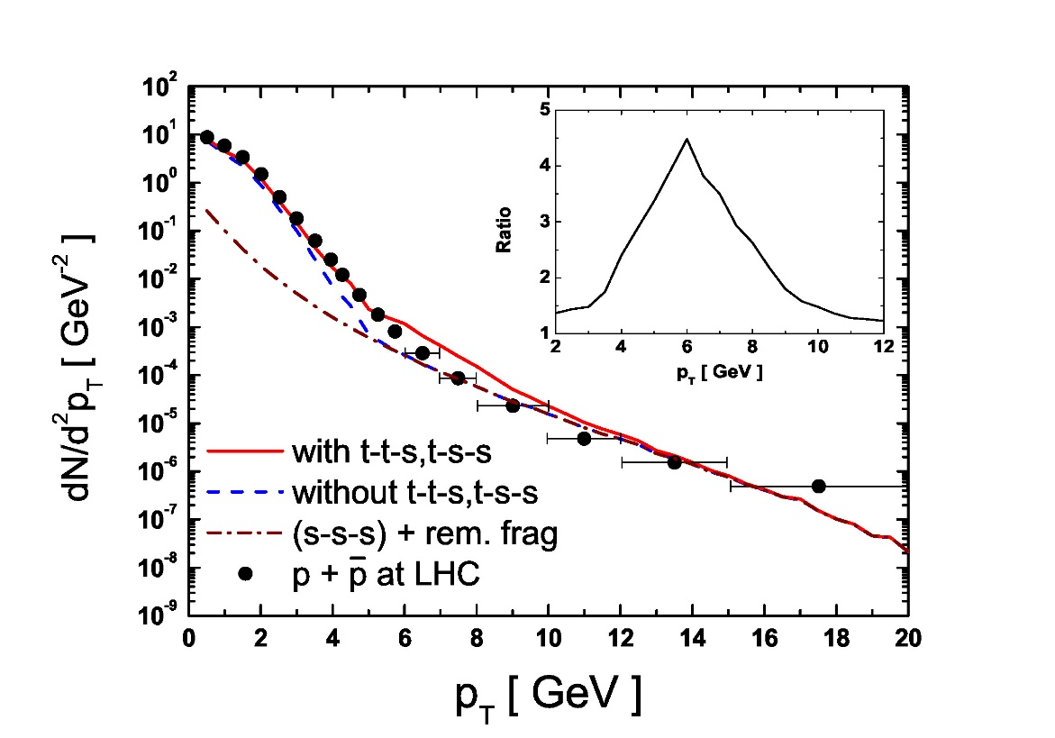
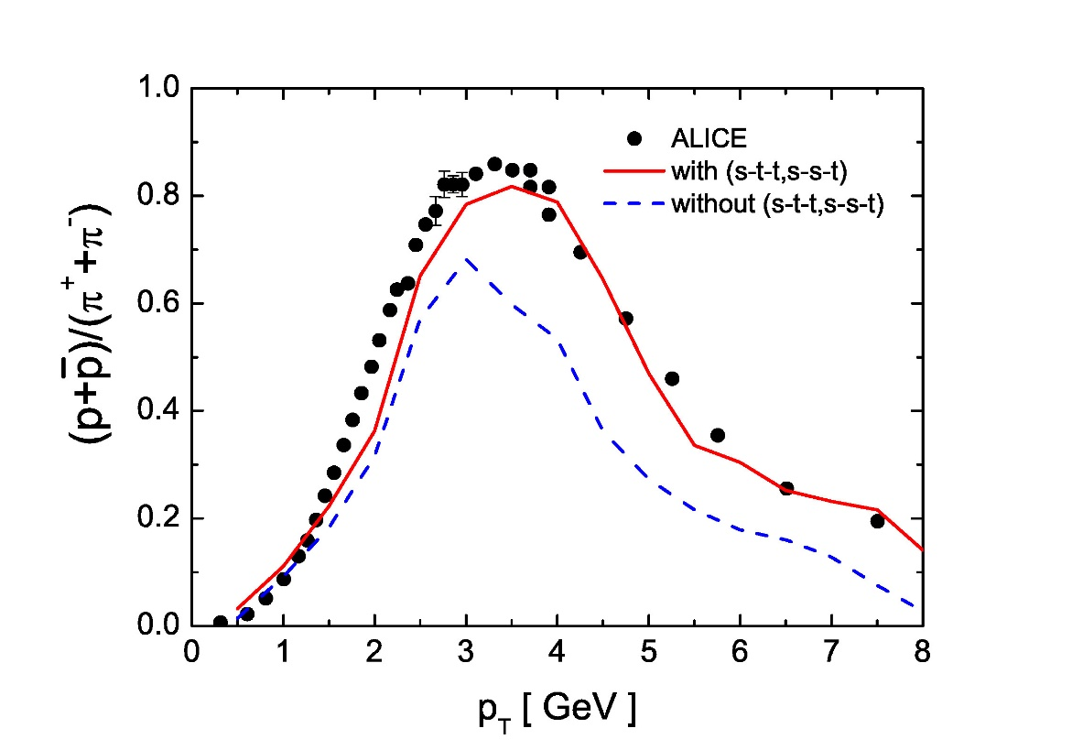
Shower-Thermal Recombination
Study with blast wave model to study the role of shower-thermal recombination.
Here: Protons at LHC.
Baryon production enhanced.

Slide 19
Plans for the Near Future
Applications to both the LBNL and WS shower MC are in the works.
Common framework
  Shower medium effects restricted to T< T_{c}.
  Partons that stop evolution inside QGP have to be propagated to the critical hypersurface unless they thermalize.
  Hadronization applied to partons at T=T_{c} and T> T_{c}.
Issues:
  Formation time after last splitting?
  Fate of recoiled medium partons.

Slide 20
A Short List of Other Topics
Open heavy flavor @ LHC: calculation of the TAMU framework with resonance recombination and non-perturbative Langevin transport.
Color glass beyond boost-invariance.
Using jets as trigger for photons from jet-medium interactions.
[M. He, RJF, R. Rapp, PLB (2014) in press]
[S. Ozonder, RJF, PRC 89 (2014)]
[S. De, RJF, arXiv:1402.1568]

Slide 21
Backup

Slide 22
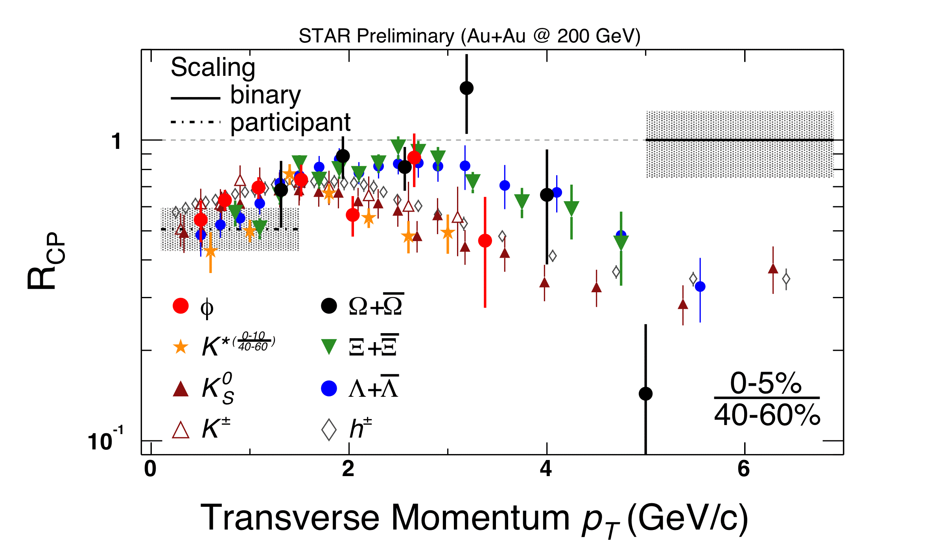
Why Quark Recombination?
Data indicates a dependence of several important observables on the number of valence quarks.
Quark coalescence models very successful for hadron production at intermediate P_{T} in HICs.
  Large baryon/meson ratios
  Elliptic flow scaling with quark number → QGP signature?

Slide 23
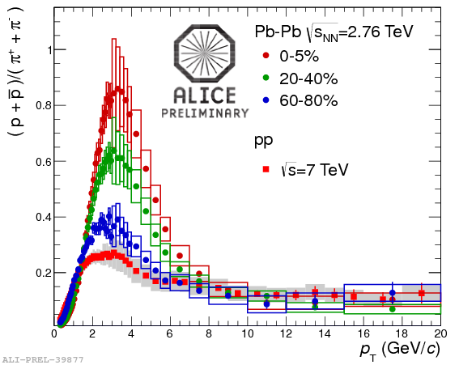
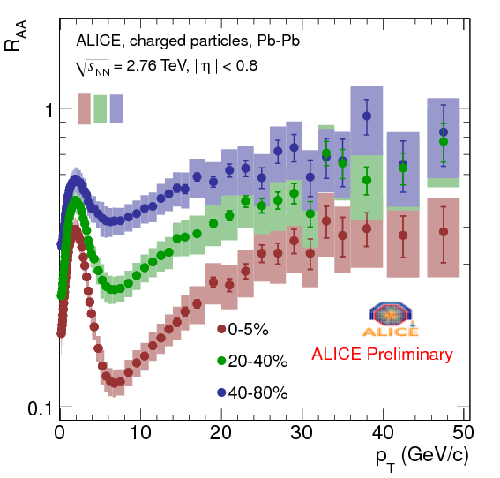
Hadrons in Heavy Ion Collisions
Proton/pion ratio
R_{AA}
Intermediate momentum region in heavy ion collisions (2-8 GeV):
  No kinetic equilibrium
  Multi-particle dynamics
  No microscopic description of parton dynamics.

Slide 24
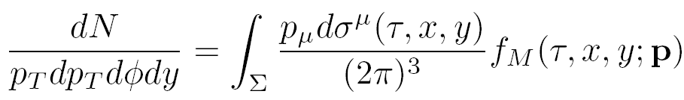
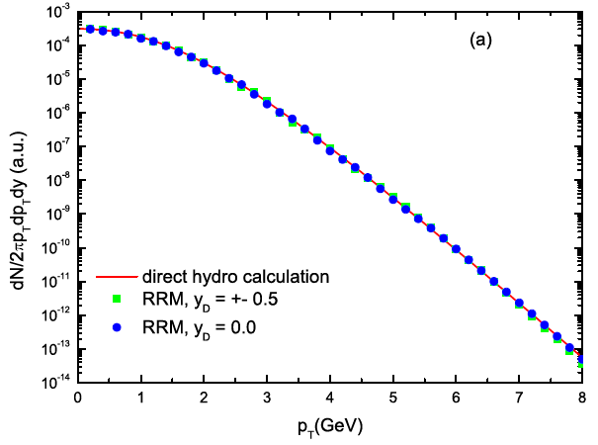
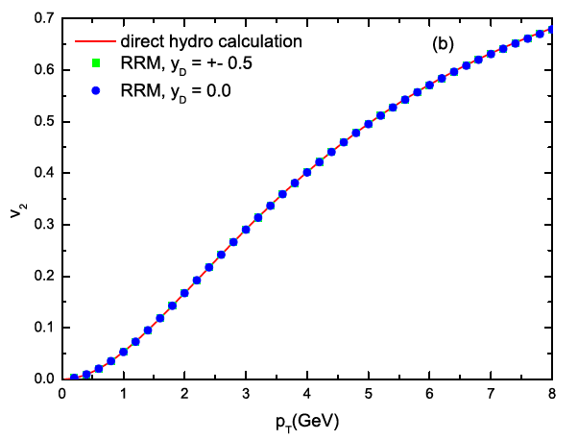
Recombination in Equilibrium
Realistic hadronization hypersurface Σ:
  Extract equal-time quark phase space
  distributions f_{q} along Σ from hydro
  or kinetic model.
  Apply RRM cell-by-cell → meson phase space distribution f_{M} along Σ.
  Compute meson current
  across Σ a la Cooper-Frye:
Result for charm-light system using AZHYDRO:
t = const.
[He, RJF & Rapp,
1106.6006 [nucl-th]]

