Slide 1
Colorado group activities
JET Collaboration Meeting
Paul Romatschke, CU Boulder

Slide 2
Topics
Matching AdS/CFT with hydro
Small system flow
Lattice Boltzmann for relativistic hydro

Slide 3
Matching AdS/Hydro
Far from equilibrium evolution extremely hard in QCD at large coupling
‘Easy’ for N=4 SYM
Recipe: replace collision process/pre-equilibrium evolution in QCD by N=4 SYM

Slide 4
Some ‘issues’ of N=4 SYM may not be so bad:
While QCD is not conformal, we apply our model only at T>400 MeV where c_{s}²~0.3
QCD is confining but at T~170 MeV, much below the scale we stop applying our model
N_{c}=∞ may not be such a bad description of N_{c}=3 in view of success of large N_{c} QCD
So if we’re interested in the bulk dynamics of a gauge theory at strong coupling, AdS/CFT may even be quantitatively close to sQCD

Slide 5



Heavy Ion Collisions as BH Collisions in AdS5
If we are willing to accept these ‘approximations’, then holographic renormalization lets us recast ‘nuclear collisions’ in 3+1d with
as shock wave collisions in AdS5:

Slide 6
Heavy Ion Collisions as BH Collisions in AdS5
Two infinitely boosted ‘nuclei’ superimposed become two shock waves in gravity
Extremely high-energy analogue of black-hole collisions (Aichelburg-Sexl shock waves)
Hard to treat collision process via numerical relativity
Some insight may be gained analytically

Slide 7

Shock Wave Collisions in AdS₅
Coordinate Transformation turns delta-functions into C₂ functions in the metric:

Slide 8

pGR shock collisions
Analytic results predicts non-equilibrium ‘flow’:
Pre-equilibrium transverse flow is consistent with ideal hydro (with s=ρ(r))
Pre-equilibrium energy density evolution is NOT consistent with hydro
u^{ξ}=3 τ² ρ(r) ξ
[Grumiller&PR 2008; PR & Hogg 2013]

Slide 9
Shock Wave Collisions in AdS₅: perturbative GR (pGR)
Close to collision point u=0, v=0, may find line element after collision by solving Einstein Equations (‘early time perturbation theory’)
Via AdS/CFT, can obtain information about QFT energy-momentum tensor
[Grumiller&PR 2008; PR & Hogg 2013]
Problem: Expansion uncontrolled close to horizon, would need to resum (see Bhattacharyya & Minwalla, JHEP 909])

Slide 10
From pGR to full GR
Use analytic post-collision line element to obtain (approximate) initial data & follow full evolution using numerical GR
Simplest case: planar shocks --- we did this using a characteristic scheme (Chesler-Yaffe)
More realistic: shocks with transverse profile (corresponding to head-on ‘nuclear’ collisions)
[Wu & PR, 2011]
[van der Schee, PR & Pratt, 2013]

Slide 11
AdS+hydro+cascade
We are able to follow dynamics until (and beyond) equilibration
Resulting Energy-Stress Tensor is used as initial data in subsequent hydrodynamic evolution code (matching) with QCD EoS
Hydro evolution proceeds until system has cooled below QCD phase transition. Evolution is stopped and data is fed into a standard hadron cascade code
Particle spectra from cascade are compared to experiment

Slide 12
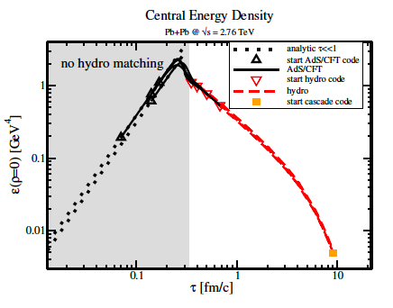
AdS+hydro+cascade
[van der Schee, PR & Pratt, 2013]

Slide 13
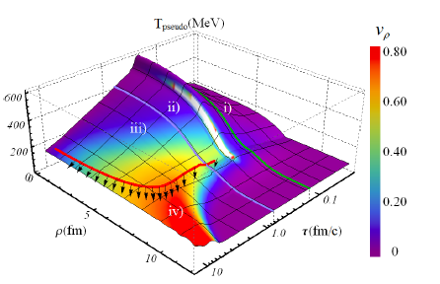
AdS+hydro+cascade
[van der Schee, PR & Pratt, 2013]

Slide 14
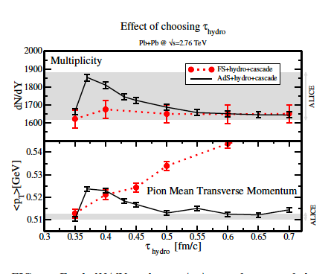
AdS+hydro+cascade
[van der Schee, PR & Pratt, 2013]

Slide 15
AdS+hydro+cascade
AdS/CFT+hydro results are independent of choice of switching time
You get what you get. No ‘tuning’

Slide 16
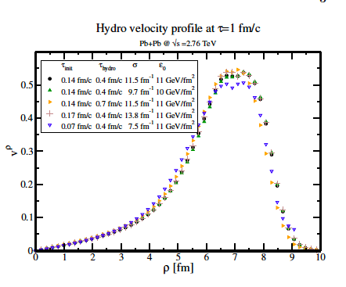
Shocks with Transverse Profiles
[van der Schee, PR & Pratt, 2013]

Slide 17
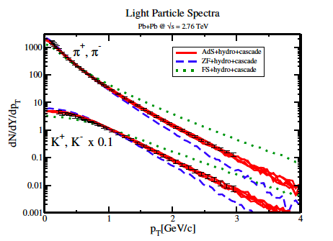
Shocks with Transverse Profiles
[van der Schee, PR & Pratt, 2013]

Slide 18
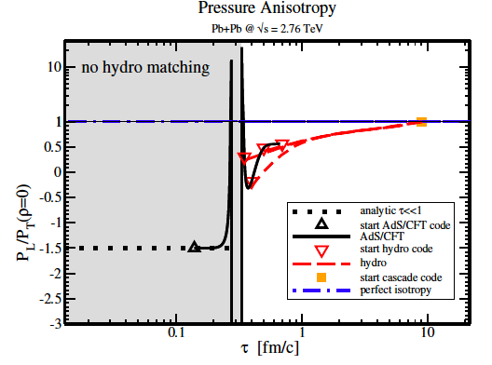
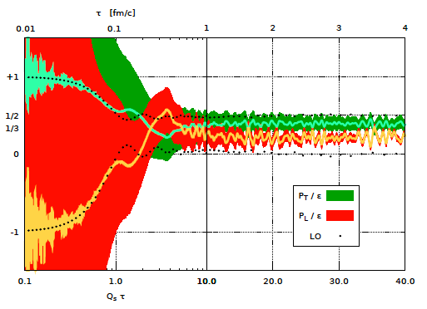
Strong vs. Weak Coupling
g=∞
g=0.5
[van der Schee, PR & Pratt, 2013]
[Epelbaum, Gelis, 2013]
How about making more comparisons like these???

Slide 19
Matching AdS/hydro
AdS/CFT is robust tool to model early-time heavy-ion collisions at very large coupling
Leads natural to thermalization for τ>0.5 fm/c
Results have fewer parameters than standard hydro models, but still depend on regulator
Wish list:
Simulate non-central and ‘lumpy hotspot’ shocks
Finite Coupling Corrections (match dN/dY_{experiment}?)
Perform boosted BH collisions in AdS₅
Weak coupling thermalization results to compare to

Slide 20
Small system flow: pA,dA and He³A
Use Glauber model for position of nucleons for A
Use Hulten/GFMC wavefunction to obtain nucleon positions for d and He³
GFMC:[Carlson & Schiavilla, 1998]
Calculate position of participating nucleons
Each participating nucleon deposits energy in form of a Gaussian with width σ=0.4 fm

Slide 21
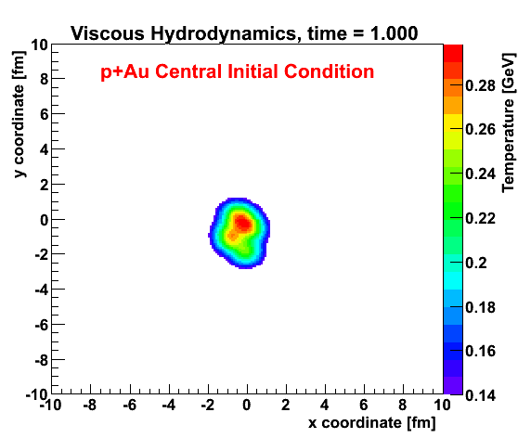
Initial geometry in pA,dA and He³A

Slide 22
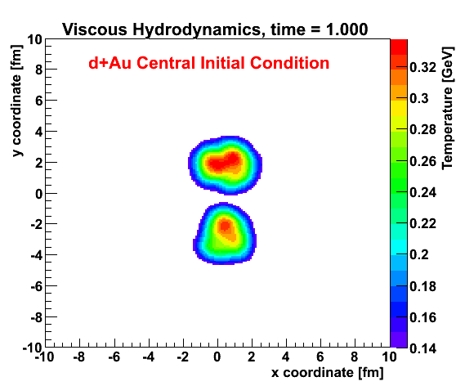
Initial geometry in pA,dA and He³A

Slide 23
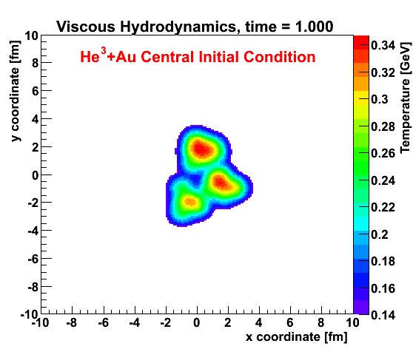
Initial geometry in pA,dA and He³A

Slide 24
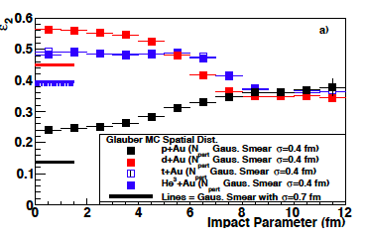
ε₂ in pA,dA and He³A

Slide 25
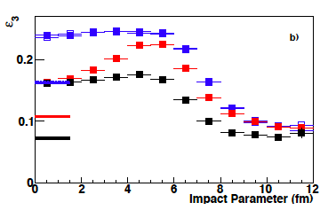
ε₃ in pA,dA and He³A

Slide 26
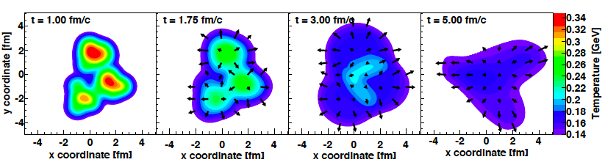
Spatial to Momentum Conversion via viscous hydro
Standard viscous hydro (vh2+1, Luzum/Romatschke);
well tested

Slide 27
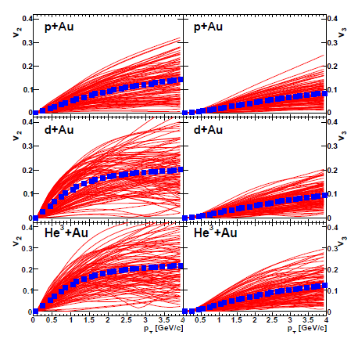
Primordial pions, pure hydro, η/s=1/4π τ₀=1 fm/c
T_{F}=150 MeV, high multiplicity
consistent with
P. Bozek’s
results
arXiv:1312.4565

Slide 28
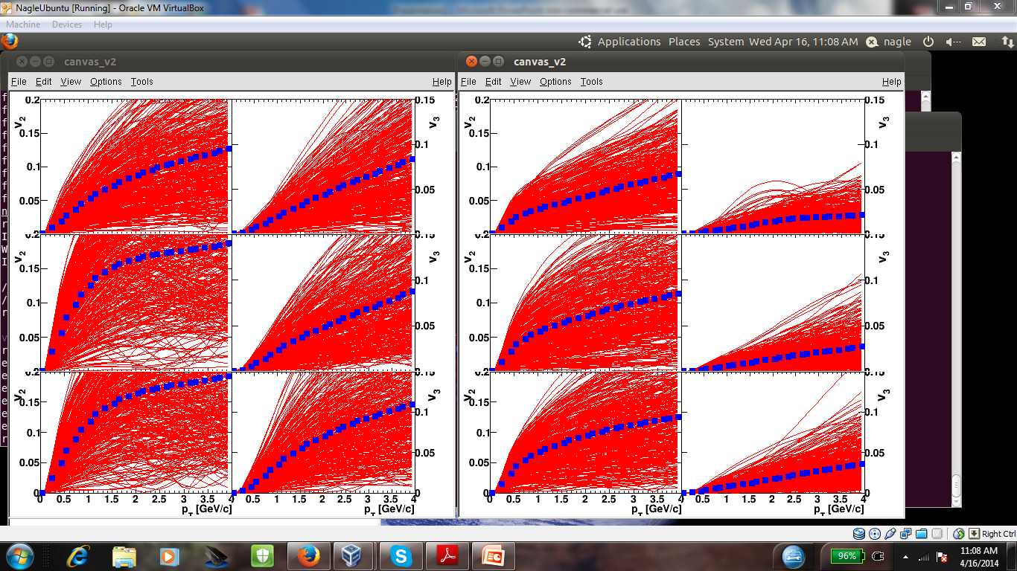
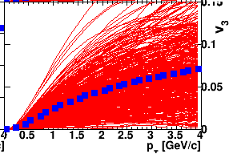
He3 + Au
Tf=135 MeV
Strong T_{F} dependence of v₃ in pure hydro: if system does not live long enough, triangularity not translated into v3
Try to remediate by running hadron cascade after hydro (with Tf=170 MeV transition)
Finding: cascade does not boost the v3 much (large η/s!)
System does not have enough time, expect small (but measureable) v3 values!
Tf=150 MeV
Tf=170 MeV

Slide 29
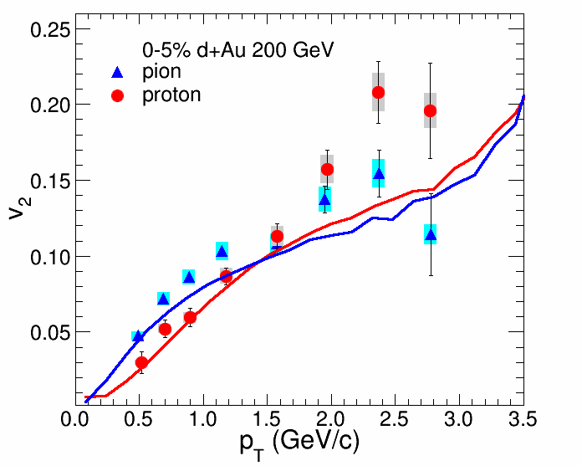
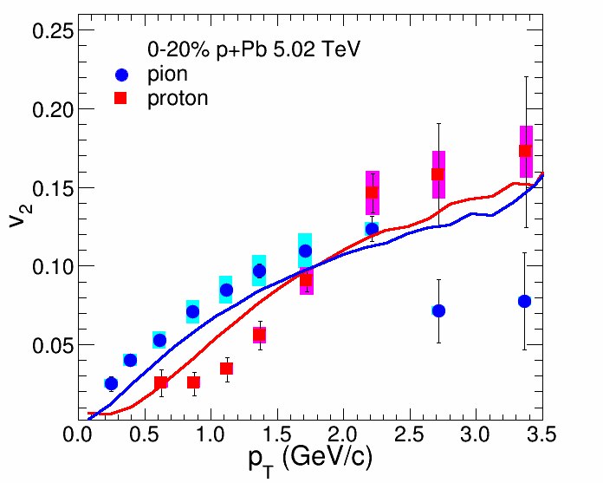
Hydro+cascade model vs. data
Using hydro η/s=1/4π, τ0=0.5fm/c, Tfreeze = 170 MeV, then cascade and the right initial energy deposited, we get reasonable d+Au (RHIC) and p+Pb (LHC) v2 results.
All other groups run pure hydro
RHIC d+Au
LHC p+Pb
ALICE data
PHENIX data

Slide 30
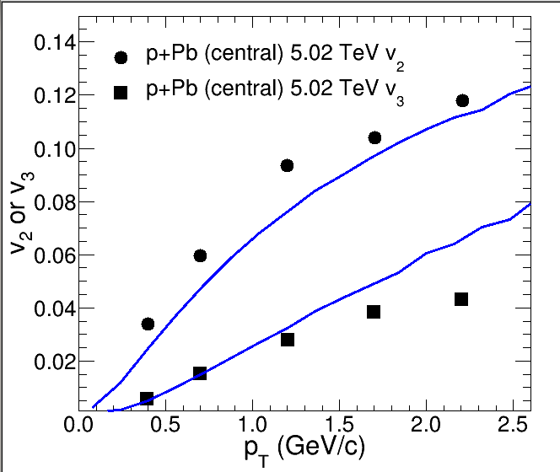
Hydro+cascade model vs. data
Model gives reasonable agreement with LHC v2 and v3 data for p+Pb
CMS data
Note: IP-Glasma+MUSIC does not!

Slide 31
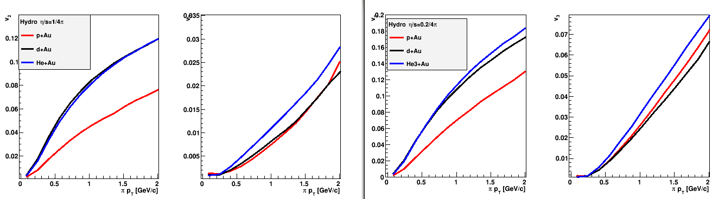
Full viscous hydro (T_{F}=170 MeV) + hadronic cascade
Now for He3+Au, d+Au, p+Au
Hydro η/s = 1/4π
Hydro η/s = 0.2/4π
v2
v3
v2
v3
Ordering between systems is preserved, but the
v₃ values are smaller than in the original arXiv paper where hydrodynamics was run down to T_{fo} = 150 MeV
For η/s=1/4π, He3+Au v₃ at p_{T}=2GeV is 3% instead of
original 7% (in pure hydro from arXiv)

Slide 32
Small system flow
Small systems flow if hot enough (‘high’ dN/dY)
Hydro models strained, signals of hydro breaking down?
Comparing p+A, d+A and He³+A may help unfold initial state/medium ambiguities
He³+A: Run-14 @ RHIC (THIS WEEK!)

Slide 33

Lattice Boltzmann
In the limit of τ->0, Boltzmann equation corresponds to hydrodynamics
BUT: it’s 3+3+1 evolution, very expensive!
Idea: sparsely discretize 3 velocity dimensions

Slide 34


Lattice Boltzmann
Expand f in terms of polynomials
Require certain integrals to be exactly representable as sums

Slide 35
For relativistic hydro, only need T^{ab}
Very restricted subset of integrals over polynomials
Small number of polynomials needed
Implies small number of velocity vectors are enough
Can find ‘optimal’ set of velocity vectors by using quadrature rules to get integrals represented as sums

Slide 36
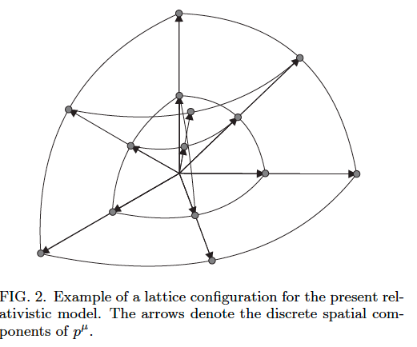
D3S18 lattice
Massless particles: 18 lattice vectors enough to fiducially reproduce hydro

Slide 37
Numerical Instabilities
In pratice, expansion is stopped at finite n
While f_{eq} is strictly positive, polynomial expansion is not
Leads to instability in LB evolution; easy to understand via entropy (f log f) no longer following H theorem

Slide 38
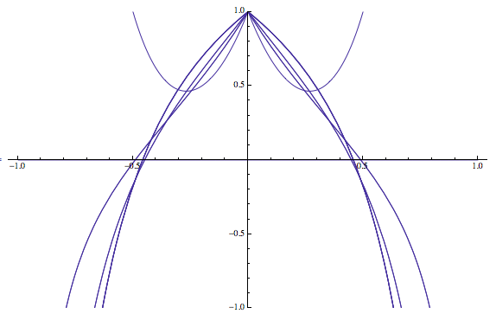
Numerical instabilities
f_{eq}(v)
v

Slide 39
Stabilize f_{eq}
I spent several months trying to implement non-relativistic LB fix to relativistic case: ‘entropic stabilization’
Basic idea: add terms to f_{eq} that are non-hydrodynamic polynomials (don’t change hydro) with coefficients to make f_{eq} positive definite
Upshot: it works up to v~0.55, but fails at high v
The end of LB for heavy-ion collisions???

Slide 40
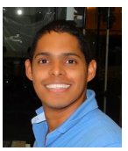
Stabilize f_{eq}
June 2-6, 2014: ‘Mini-workshop’ on Lattice Boltzmann at CU Boulder
Miller Mendoza, ETH Zurich
teaches us new trick in non-rel
LB: ‘f0’ stabilization
Idea: add new velocity vector, v=(1,0,0,0) that takes up all the negative contribution
This vector does not propagate negativity

Slide 41
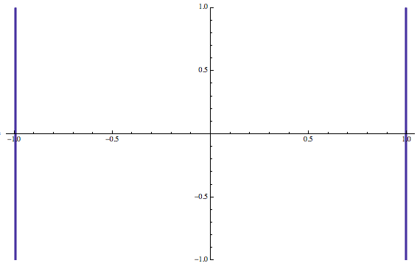
f0 stabilization
f_{eq}(v)
v

Slide 42
Lattice Boltzmann summary
Elegant new algorithm for relativistic hydro with large gradients/viscosities
New problems: numerical instabilities (violation of H-theorem)
New formulation (f0 stabilization) cures negative f_{eq} entries, expect better stability
Still needs lots of testing!

Slide 43
Bonus Material

Slide 44
Details cascade
Written by S. Pratt
All resonances in PDB (masses < 2.2 GeV)
Switching temperature T=170 MeV (too high?)
Implements decays under strong force

Slide 45
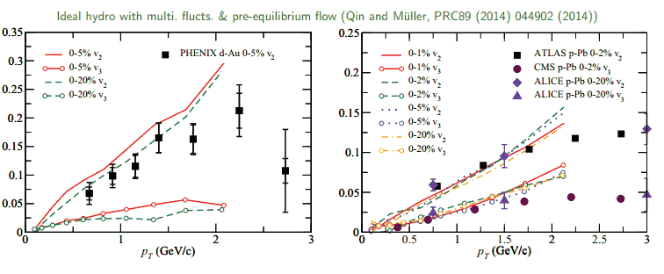
Flow not only in high dN/dY
From U. Heinz’s talk @ ECT* 2014

