Slide 1
Flow and “Temperature” of the Parton Phase from AMPT
Zi-Wei Lin
Department of Physics
East Carolina University
Based on arXiv:1403.6321
(to appear on Phys Rev C);
Only addresses partons within
space-time rapidity |η|<1/2

Slide 2
Outline
Motivation
Constraining parameters of the AMPT-String Melting model
Evolution of flow, densities and energy-momentum
Evolution of extracted effective temperatures
Over-population of partons
Summary

Slide 3
Motivation
Use thermodynamic variables to describe
the bulk parton matter (usually in non-equilibrium) modeled by transport
This provides a link between
transport model and
Hydrodynamics
Other studies that use thermodynamic variables (T, ε, ...) to model the physics
In particular,
evolution of thermodynamic variables of the bulk parton matter
provides another soft background
for jet quenching and energy loss studies.
Evolution data posted at http://myweb.ecu.edu/linz/ampt/evolutiondata/ ;
also linked at the JET Collaboration wiki page
https://sites.google.com/a/lbl.gov/jetwiki/code-packages/hydro-evolution/

Slide 4
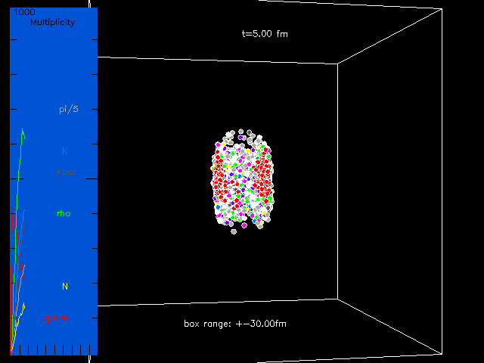
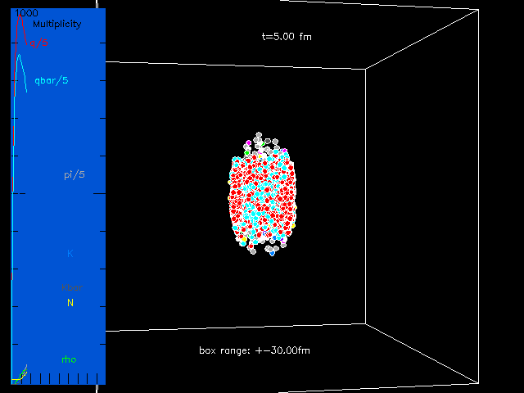
The same central 200AGeV Au+Au event (at t=5 fm/c) from
AMPT-Default vs AMPT-String Melting (SM)
Constraining parameters of the AMPT-SM model
Beams from the left & right sides
AMPT-SM: early parton stage dominates; hadron stage starts later.
describes v2 & HBT
Not dN/dy or p_{T} -spectra
AMPT-Default:
describes dN/dy & p_{T} -spectra
Not v2 or HBT

Slide 5
Constraining parameters of the AMPT-SM model
Goal: fit low-pt (<2GeV/c) π & K data on dN/dy, p_{T} –spectra & v2
in central (0-5%) and mid-central (20-30%)
200AGeV Au+Au collisions (RHIC) and 2760AGeV Pb+Pb collisions (LHC)
 | HIJING1.0 | AMPT-SM [1] | AMPT-SM in [2] | AMPT-SM in this Study
Lund string a | 0.5 | 2.2 | 0.5 | 0.55 for RHIC, 0.30 for LHC
Lund string b (GeV⁻²) | 0.9 | 0.5 | 0.9 | 0.15
α_{s} in parton cascade | N/A | 0.47 | 0.33 | 0.33
Parton cross section | N/A | ~ 6 mb | 1.5 mb | 3 mb
Model describes | pp, … | v2 & HBT not dN/dy or p_{T} | dN/dy & v2 (LHC) not p_{T} | dN/dy, p_{T} & v2 (RHIC & LHC)
[1] Lin, Ko, Li, Zhang and Pal, Phys Rev C 72, 064901 (2005); etc.
[2] Xu and Ko, Phys Rev C 83, 034904 (2011).
Notes:
Also set upper limit on the strangeness quark suppression factor as 0.4.

Slide 6
Constraining parameters of the AMPT-SM model
dN/dy of π & K:

Slide 7
Constraining parameters of the AMPT-SM model
p_{T} -spectra of π & K (in central collisions):

Slide 8
Constraining parameters of the AMPT-SM model
v2 of π & K (in mid-central collisions):

Slide 9
Evolution of flow, densities and energy-momentum
Transverse flow
in RHIC central:
the transverse plane
at 1 fm resolution:
X
X
This study averages over
many events
(for the same collision system at the same centrality);
thus e-by-e fluctuations
are neglected

Slide 10
Evolution of flow, densities and energy-momentum
Transverse flow
in RHIC central:
at 2 locations along x:
β_{y}≈0 due to symmetry
Flow ≈ β_{x} :
shape depends on location;
decrease seen at late times;
develops fast near
edge of overlap volume

Slide 11
Evolution of flow, densities and energy-momentum
Transverse flow
in RHIC central:
shape at different times
Significant flow
near the edge
even at t=1fm/c
Flow at early times:
~ Pre-equilibrium flow,
modeled by elastic parton cascade here
Notes:
We can see the decrease of flow in the inner part (|x|<5fm)

Slide 12
Evolution of flow, densities and energy-momentum
Example:
the center cell
in RHIC central
All evaluated in the rest frame of each cell

Slide 13
Evolution of extracted effective temperatures
Extract effective temperatures
using relations for a massless ideal QGP
with the Boltzmann momentum distribution:
Each variable gives a “temperature”:
If their values are different for a cell
The local parton system in the cell
is not in full equilibrium
Difference between Boltzmann and quantum
distributions is very small for these relations
Notes:
Note: for Nf = 3 quantum distributions would give n≃5.24T^3 and ε=15.6T^4,
which are very close to the relations n≃5.27T^3 and ε≃15.8T^4 when the Boltzmann distribution is used for massless partons.

Slide 14
Evolution of extracted effective temperatures
➔
The effective temperatures
are all different.
For the center cell in RHIC-central:
in the dense phase

Slide 15
Evolution of extracted effective temperatures
is true for the center cell of all 4 collision systems:
Notes:
Relation for Te is good within 6% in the dense phase (T>100MeV).
So we will focus on Te and T<pt> now, not Tn.

Slide 16
Evolution of extracted effective temperatures
How about other locations?
➔ over the inner part of the overlap volume;
the opposite over the outer part.
Notes:
T<pT> is quite flat

Slide 17
Evolution of extracted effective temperatures
This is the case in all 4 collision systems:
Notes:
We see that T<pt> does not change much with centrality (in the inner part);
It just gets narrower in x.

Slide 18
Evolution of extracted effective temperatures
in RHIC central
over the transverse plane:
Note again:
for partons
within |η|<1/2

Slide 19
Over-population of partons
For the center cell:
Expect density for an ideal QGP
at temperature
We have seen: for each cell in the inner part of the overlap volume
Energy and number densities ε, n are too high, relative to the expected values
for an ideal QGP at (that has the same <p_{T}> as partons in the cell)
The local parton system is over-populated.
Quarks/antiquark densities are limited by the Pauli principle
➔Gluons must be over-populated.
Notes:
T<pT> is quite flat

Slide 20
Over-population of partons
Transverse plane of LHC mid-central (b=7.8fm)
Terminology:
QGP cell: cell with ε >1.05 GeV/fm³
Over-populated cell:
QGP cell with
• QGP cells at t=0.2 fm/c
■ Over-populated cells at t=0.2 fm/c
Δ Over-populated cells at t=3 fm/c
Over-population in inner part of overlap volume;
many over-populated cells even after several fm/c
Notes:
e=1.05 GeV/fm3 corresponds to Te=150MeV (for Nf=3).
At t=3fm/c, over-p cells=QGP cells.

Slide 21
Over-population of partons
Transverse area:
50-70% of initial QGP cells
are over-populated.
After 2-3 fm/c,
all QGP cells are over-p.

Slide 22
Over-population of partons
Evaluate parton phase-space density function f(p) in center cell of LHC central:
compared with equilibrium functions
fails in magnitude
fails in slope
Notes:
fQGP at Te cannot describe slope; fQGP at T<pt> cannot describe magnitude.
fquantum is only dfferent at very low pt and cannot describe the over-population.

Slide 23
Over-population of partons
Compare f(p) in center cell of LHC central with non-equilibrium functions:
are quark & gluon phase-space occupancy factors, respectively
Set T as , then
match ε of the cell
➔an equation
relating and
Pauli principle
f(p) can be described well by non-equilibrium functions, with
Notes:
For quantum distribution: gamma_q in [0,2]? Better to use Fermi energy instead of gamma_q?
Gamma_g [23.1, 25.1] for a) and [11.1, 13.1] for b) using quantum f(p);
[24.9, 27.2] for a) and [11.9, 14.2] for b) using Boltzmann f(p).

Slide 24
Over-population of partons
Can also use gluon “chemical potential” to represent gluon over-population:
Notes:
Mu_g is up to 1GeV.

Slide 25
Summary
Effective temperatures extracted from different variables
(ε, n, <E>, <p_{T}>, … in the rest frame of each cell)
can be quite different
➔ parton matter from AMPT-SM are not in full equilibrium
over the inner part of the overlap volume
➔The parton system (at least the gluons) is over-populated there,
often by a large factor.
Parton phase-space distributions from the constrained AMPT-SM model
cannot be described by QGP in full equilibrium (Boltzmann or quantum)
can be described well by non-equilibrium QGP
(with phase-space occupancy factors )
A large gluon over-population gives
If this is true, how to incorporate such non-equilibrium distributions into hydro?

